Slide 1
STK-4051/9051 Computational Statistics Spring 2021
Slides Exercise 10
Instructor: Odd Kolbjørnsen, oddkol@math.uio.no

Slide 2
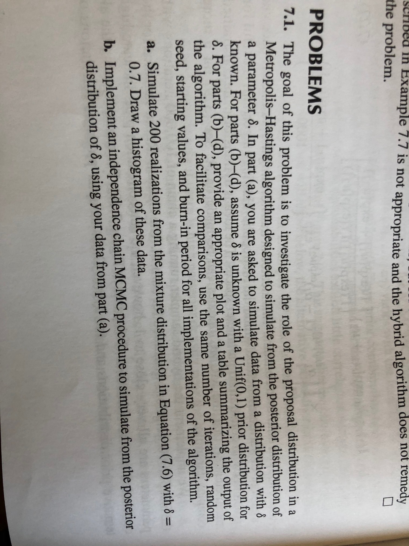
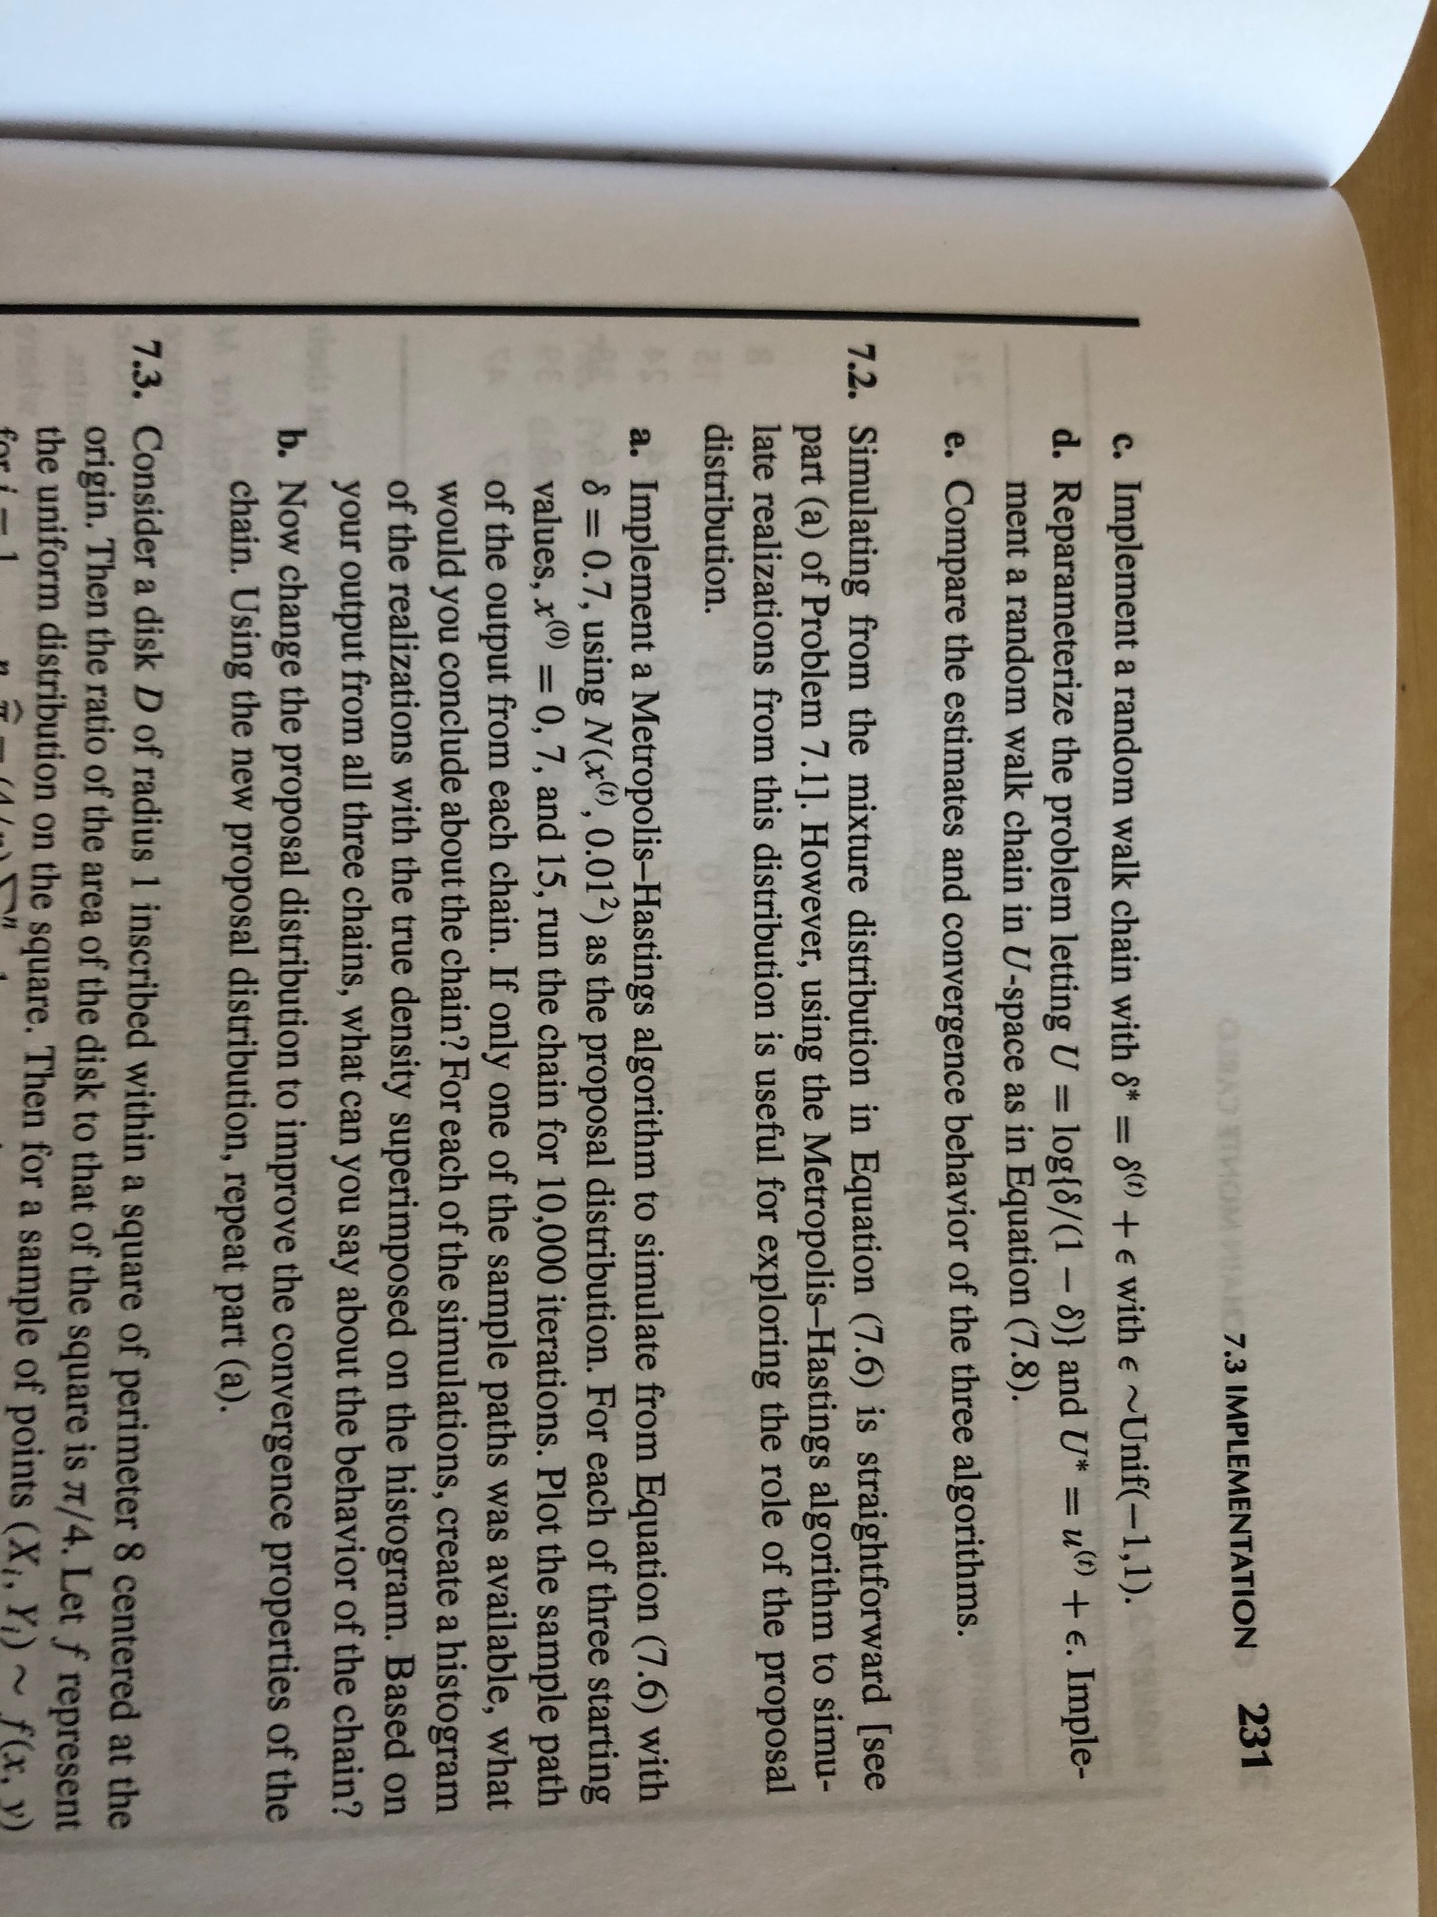

Slide 3
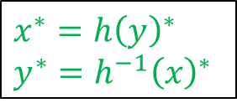
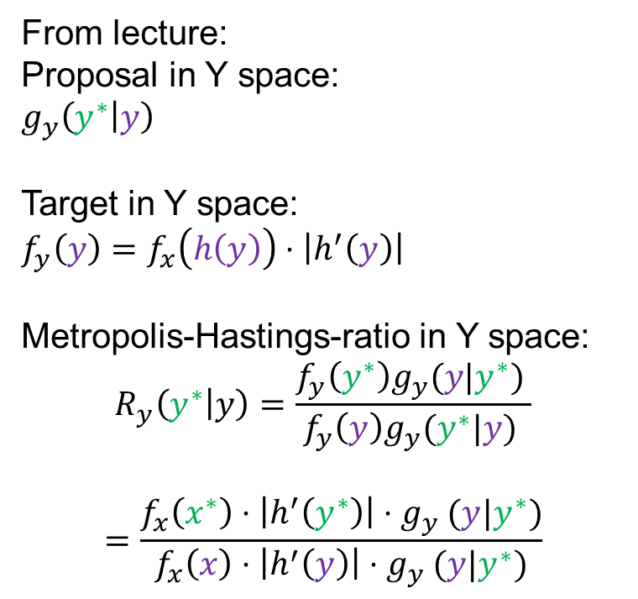
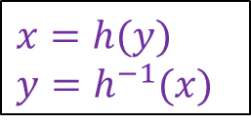
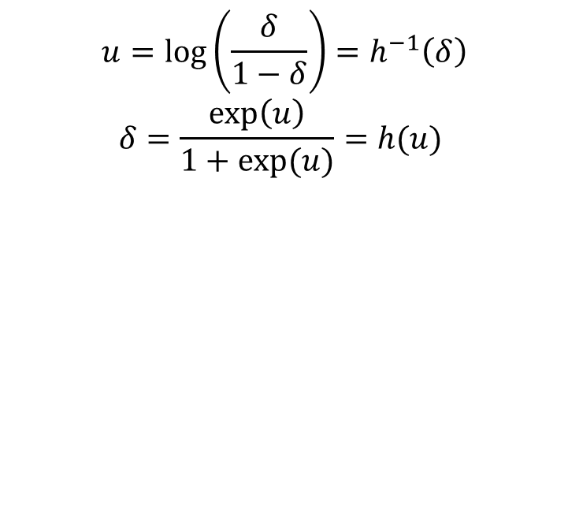
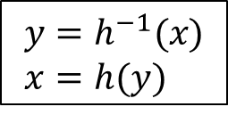
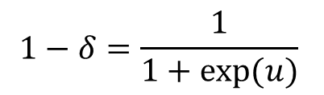
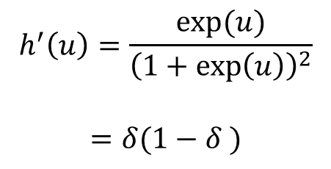
Reparameterization
From lecture:
Proposal in Y space:
$g_{y}\left(y^{∗} | y\right)$
Target in Y space:
$f_{y}\left(y\right)=f_{x}\left(h\left(y\right)\right)⋅\left|h^{′}\left(y\right)\right|$
Metropolis-Hastings-ratio in Y space:
$$R_{y}\left(y^{∗} | y\right)=\frac{f_{y}\left(y^{∗}\right)g_{y}(y|y^{∗}) }{f_{y}\left(y\right)g_{y}(y^{∗}|y) }$$
$$=\frac{f_{x}\left(x^{∗}\right)⋅\left|h^{′}\left(y^{∗}\right)\right|{⋅g}_{y}(y|y^{∗})}{f_{x}\left(x\right)⋅\left|h^{′}\left(y\right)\right|{⋅g}_{y}(y|y^{∗})}$$
$$y=h^{−1}(x)$$
$x=h(y)$
$$u=\log\left(\frac{δ}{1−δ}\right)=h^{−1}\left(δ\right)$$
$$δ=\frac{\exp\left(u\right)}{1+exp⁡(u)}=h(u)$$
$$1−δ=\frac{1}{1+exp⁡(u)}$$
$$h^{′}\left(u\right)=\frac{exp⁡(u)}{{\left(1+\exp\left(u\right)\right)}^{2}}$$
$$=δ(1−δ )$$
$x=h(y)$
$y=h^{−1}(x)$
$x^{∗}=h{\left(y\right)}^{∗}$
$y^{∗}=h^{−1}{\left(x\right)}^{∗}$

