Slide 1
STK-4051/9051 Computational Statistics Spring 2024
Ex7
Instructor: Odd Kolbjørnsen, oddkol@math.uio.no

Slide 2
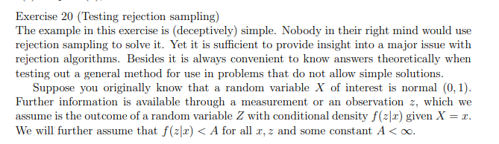
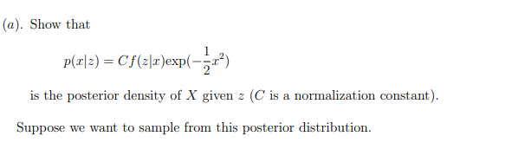

#20

Slide 3

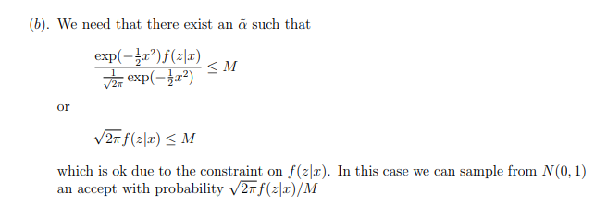

Slide 4
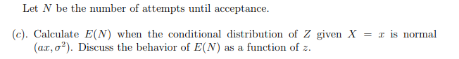
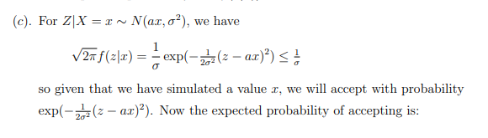


Slide 5
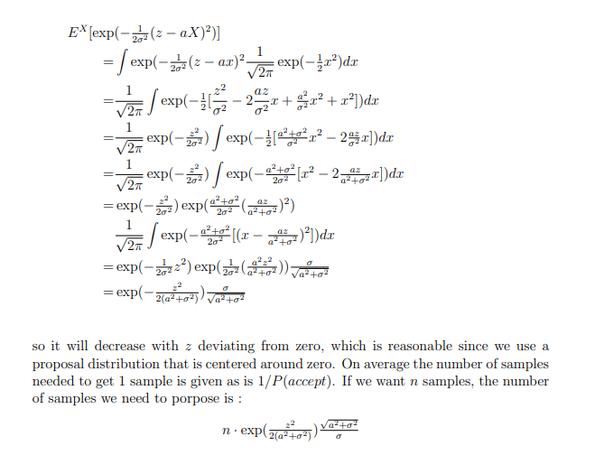

Slide 6
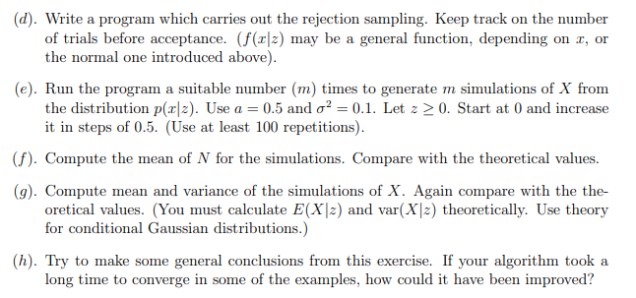
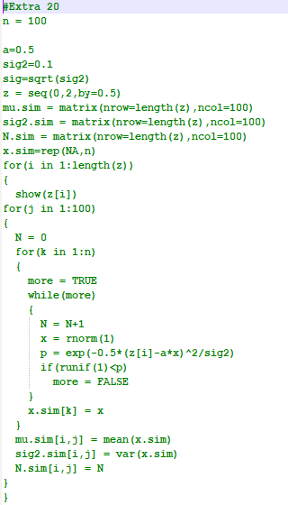

Slide 7



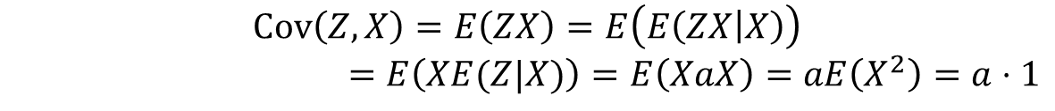
$$\left[\begin{matrix}Z \\ X\end{matrix}\right]∼N\left(\left[\begin{matrix}0 \\ 0\end{matrix}\right],\left[\begin{matrix}a^{2}+σ^{2} & a \\ a & 1\end{matrix}\right]\right)$$
$$E\left(Z\right)=E\left(E\left(Z | X\right)\right)=E\left(aX\right)=aE\left(X\right)=0$$
$$Cov\left(Z,X\right)=E\left(ZX\right)=E\left(E\left(ZX | X\right)\right)$$
$$=E\left(XE(Z|X)\right)=E\left(XaX\right)=aE\left(X^{2}\right)=a⋅1$$
$$Var\left(Z\right)=Var\left\{E\left(Z|X\right)\right\}+E(Var(Z|X))$$
$$=Var\left\{aX\right\}+E\left(σ^{2}\right)$$
$$=a^{2}+σ^{2}$$
$$E\left(X | Z\right)=μ_{X}+Σ_{XZ}Σ_{Z}^{−1}\left(z−μ_{Z}\right)=0+\frac{a}{a^{2}+σ^{2}}\left(z−0\right)=\frac{az}{a^{2}+σ^{2}}$$
$$Var\left(X | Z\right)=Σ_{X}−Σ_{XZ}Σ_{Z}^{−1}Σ_{ZX}=1−\frac{a⋅a}{a^{2}+σ^{2}}=\frac{σ^{2}}{a^{2}+σ^{2}}$$

Slide 9
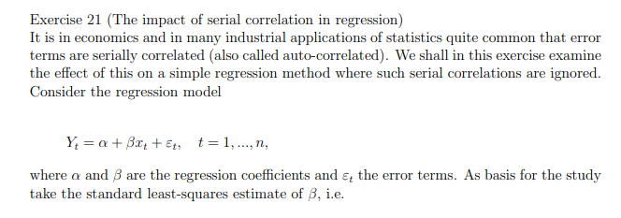
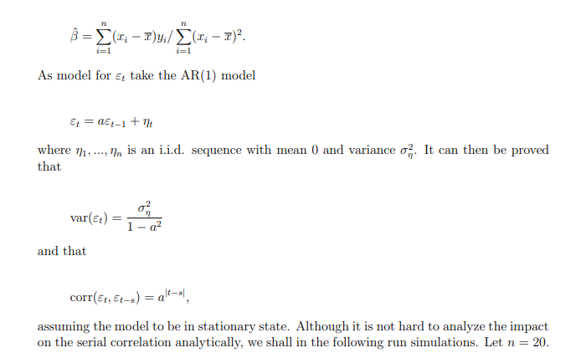
#21

Slide 10
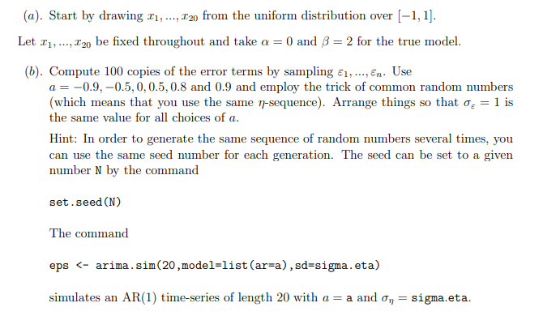


Slide 11
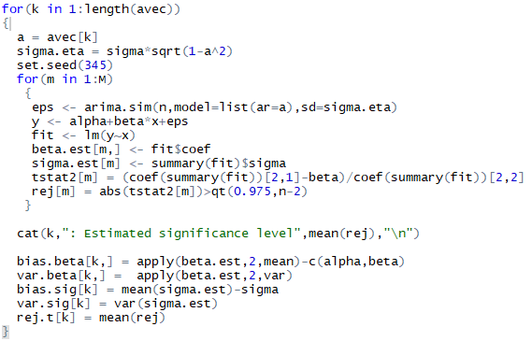
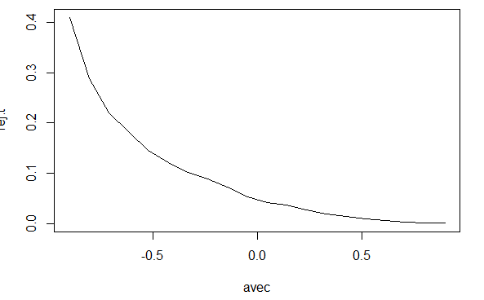
Learning:
you can investigate complex
models by simulation

Slide 12
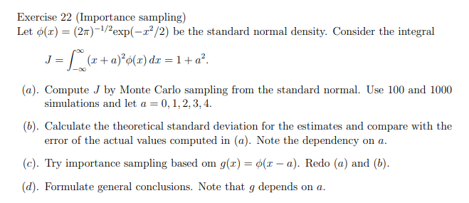
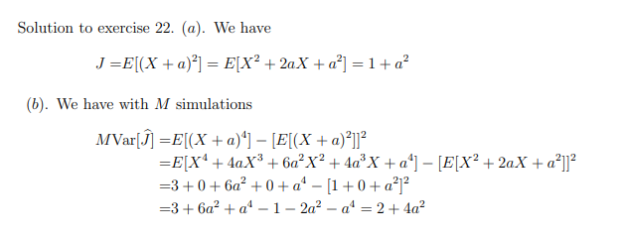
#22

Slide 13
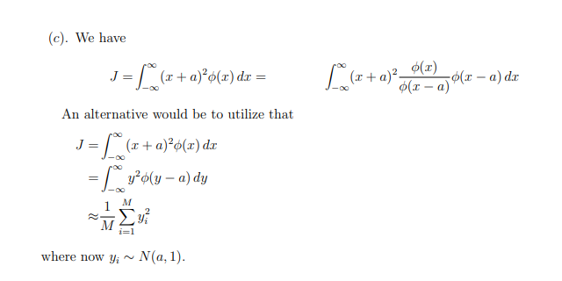

Slide 14
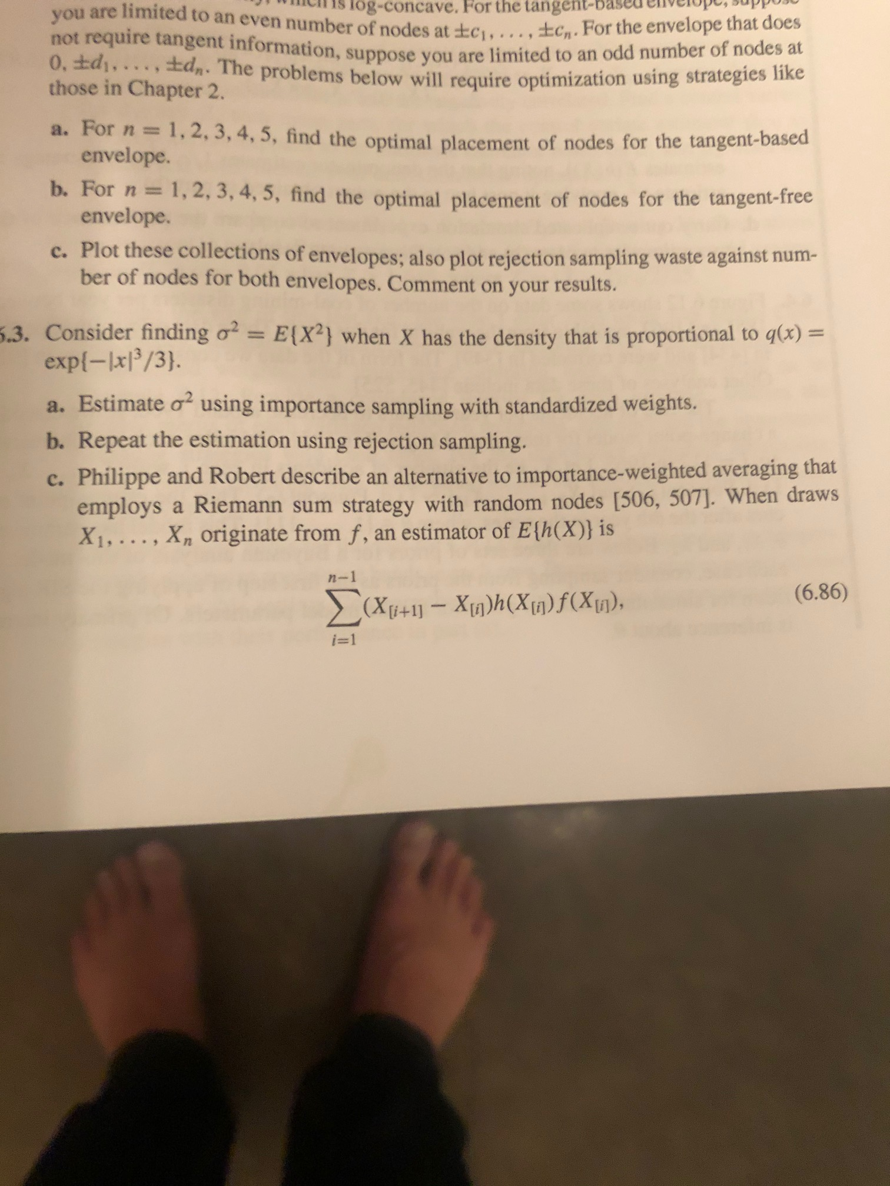
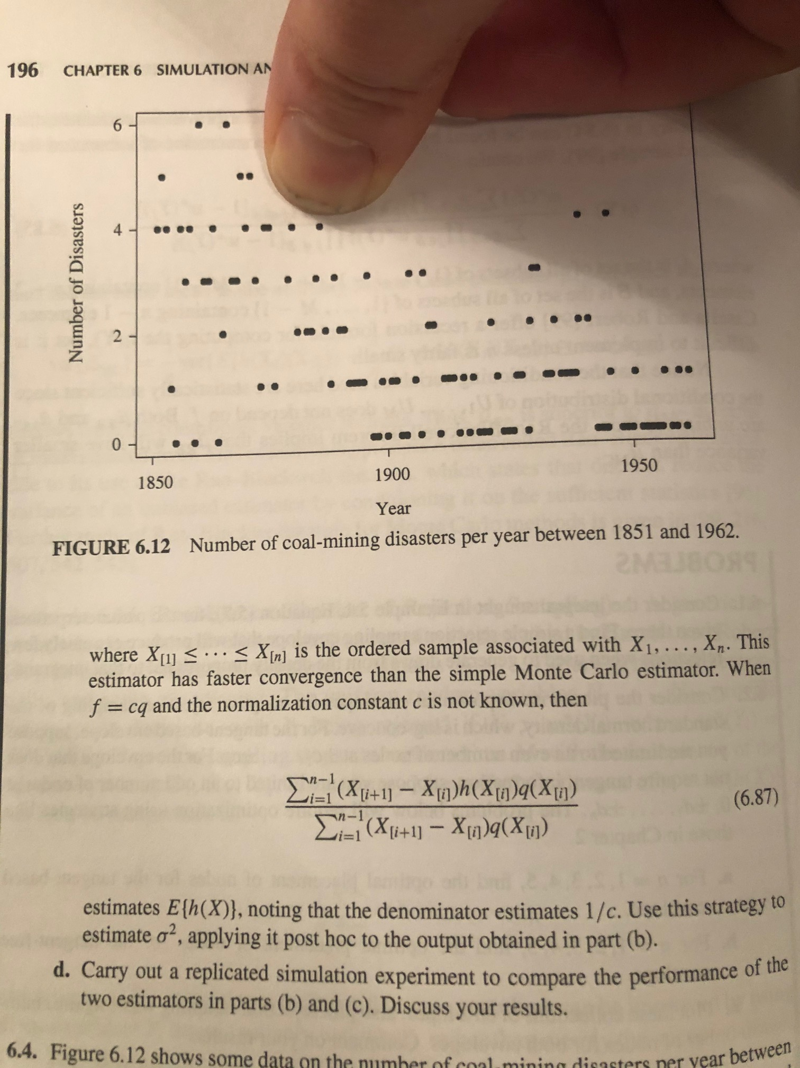
#6.3

Slide 15
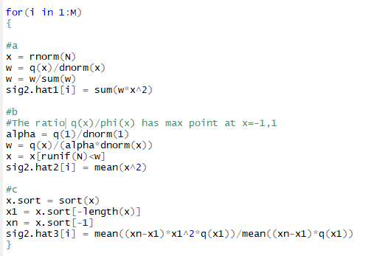
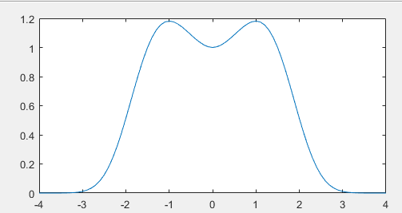


Slide 16
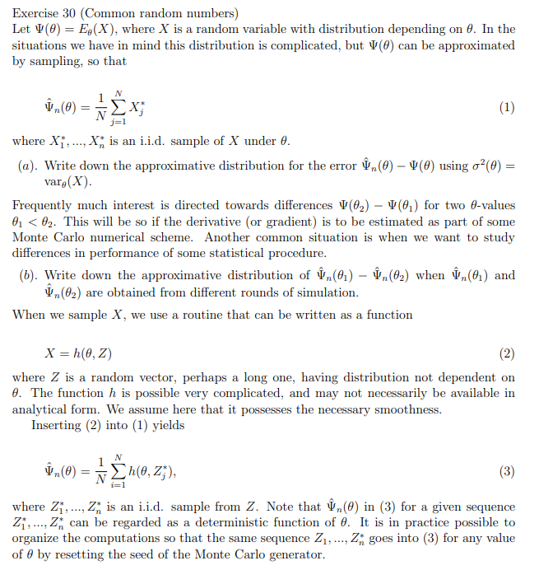
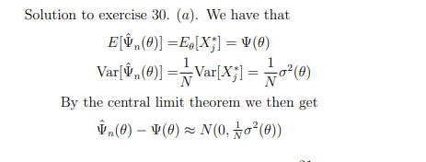

Slide 17
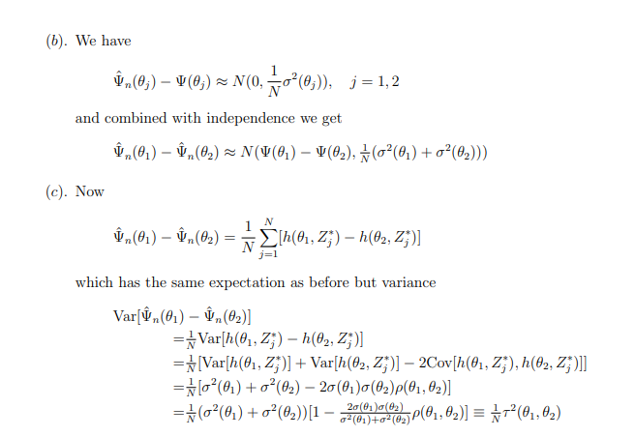

Slide 18
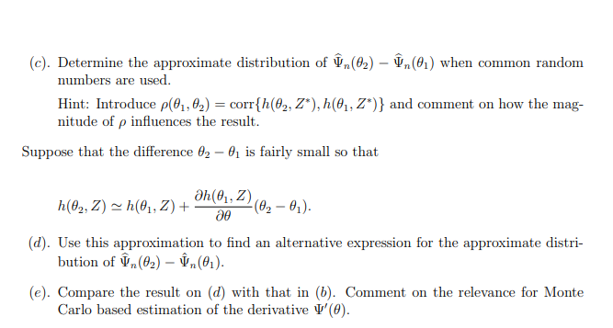

Slide 20
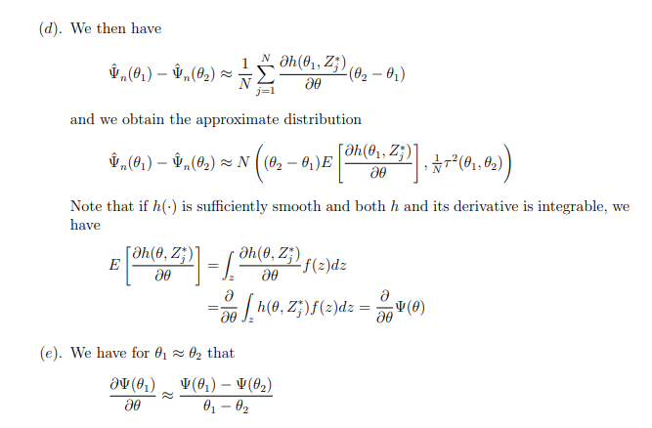

Slide 21

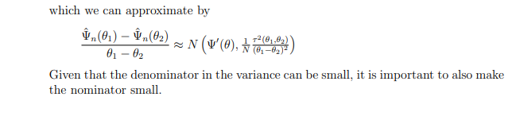

Slide 22

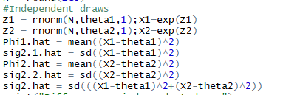
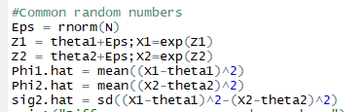
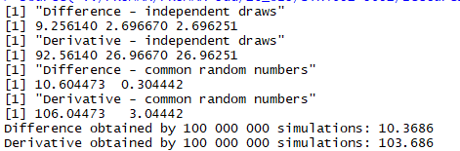
Example #30

Slide 23
Ex 30
Run the test example.
The use of correlated samples gives a 10 times improvement of the standard deviation
This corresponds to the commonly known difference between a paired test and a two sample test.

