Slide 1
Future workshop exercise
IN5510
7. September 2022

Slide 2
Background
A type of workshop developed by Jungk & Müllert (1987)
  Read more p. 152-153 in the book
Can be adapted to suit most topics
Could involve several different exercises to fit your topic and participants
Typically used in the fuzzy front end
Involves both diverging and converging

Slide 3
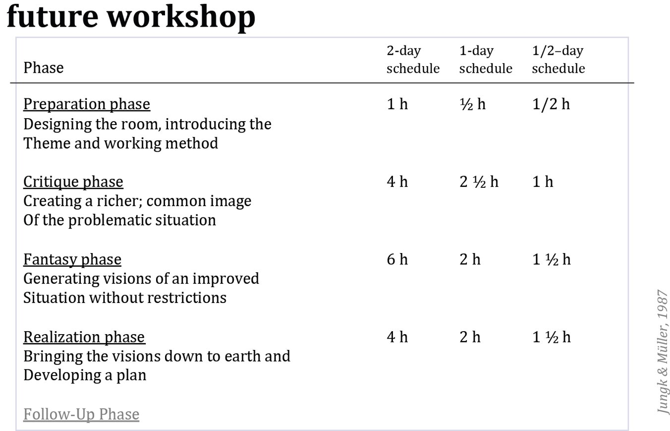
Structure of future workshops

Slide 4
Practical information
Form groups - not your project groups!
  Discuss and be inspired by other students
Use post-its, pens and paper
  Visualisation can be useful
  Colour looks nice <3
Short break today
  5+20+30+20+5 ⇨ ca 10 min break

Slide 5
“Yes and…”

Slide 6
Preparation phase
5 min
Setting up the room, introducing methods etc.
The theme: Engaging young voters

Slide 7
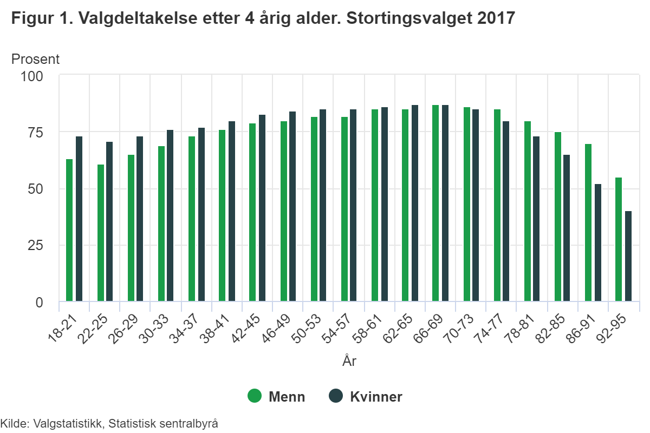
Low election turnout among young adults
Lower turnout among young men compared to women in the same age group

Slide 8
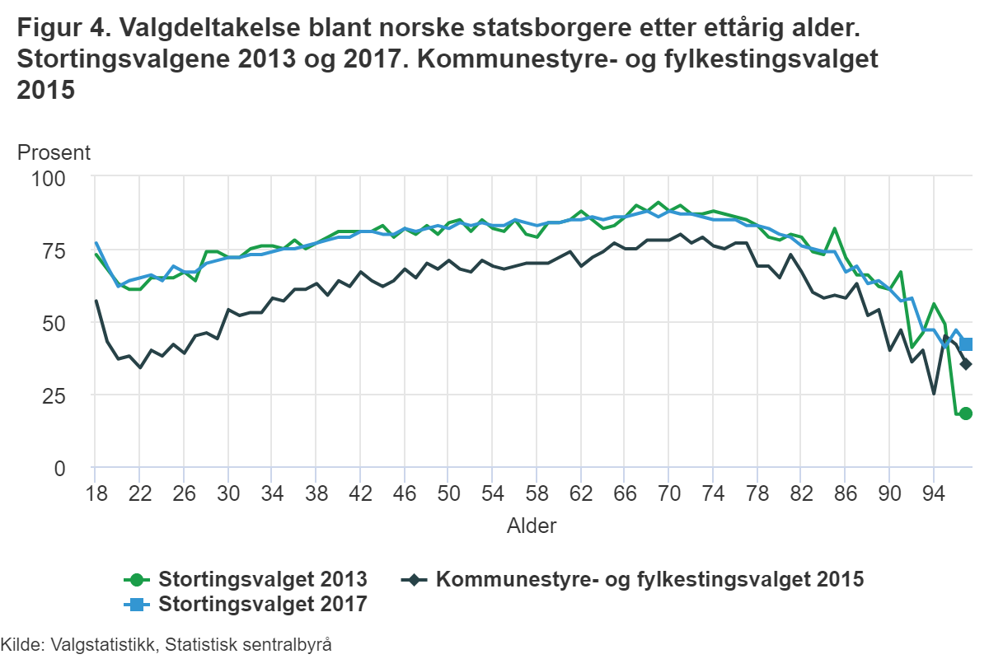
Low election turnout among young adults
Higher election turnout among young voters for Storting elections compared to municipal elections

Slide 9
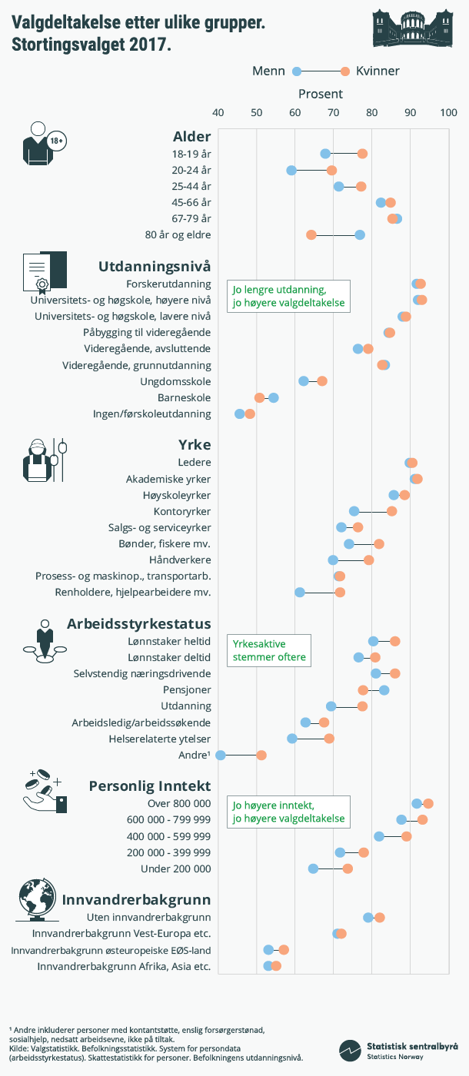
Election turnout is a complex issue
Age, education, profession, work status, income, background etc.

Slide 10
Critique phase
20 min
Brainstorm-ish​
Make a subjective list over current issues worthy of critique in today’s Norwegian election system
These critiques should not be antagonised or discussed​

Slide 11
Fantasy phase
20 min
Brainstorm-ish (still)​
The critiques should be turned into their positive counterparts​
The feasibility of these suggestions is irrelevant​

Slide 12
Realisation phase
20 min
Fantasy visions form the base of a “development” plan
Discuss what needs to be done in order to realise the vision
  Remember current technological and bureaucratic circumstances​

Slide 13
Follow-up phase
5 min
Was anything difficult or unclear?​
How is future workshop a good tool for participation?​
Any other questions about future workshop?​

Slide 14
Structure of future workshops

Slide 15
Wrap up
Why do you think we had this class?​
Is there anything you want the seminars to cover after the fall?
Any other questions?​

