Slide 1
Dialogue systems
Pierre Lison plison@nr.no
IN4080, Autumn 2024, video lecture (October 14, 2024)

Slide 2
The next two weeks
The lectures on dialogue systems will be done remotely, through a series of shorter videos
Don’t hesitate to reach out to me (plison@nr.no) or on our Discourse channel if you have any questions!
Plan:
Video 1: intro, basic chatbot models
Video 2: retrieval and generative models
Video 3: dialogue management
Video 4: system development and evaluation

Slide 3
The next 2 weeks
What are they?
What applications?
How does (human-human) dialogue actually work?
Dialogue systems
What are the core components of dialogue systems?
Can they be learned from data?
How are dialogue systems designed, built and evaluated?

Slide 4


Obligatory assignment 4
Oblig 4 released later this week
Deadline: November 3, 23:59
Two parts:
  One on dialogue systems, where you will build a simulated “talking elevator”
  One on machine translation (lecture by Yves in two weeks)

Slide 5

Dialogue systems?
A dialogue system is an artificial agent designed to interact with humans using (spoken or text-based) natural language
Dialogue system
output signal
(machine utterance)
input signal
(user utterance)
User

Slide 6

What for?
Highly intuitive: no need for training or expertise: all you need is to talk/write!
Touch-based interfaces may be inadequate, cumbersome or dangerous (car driving)
Language is the ideal medium to express complex ideas in a flexible and efficient way

Slide 7
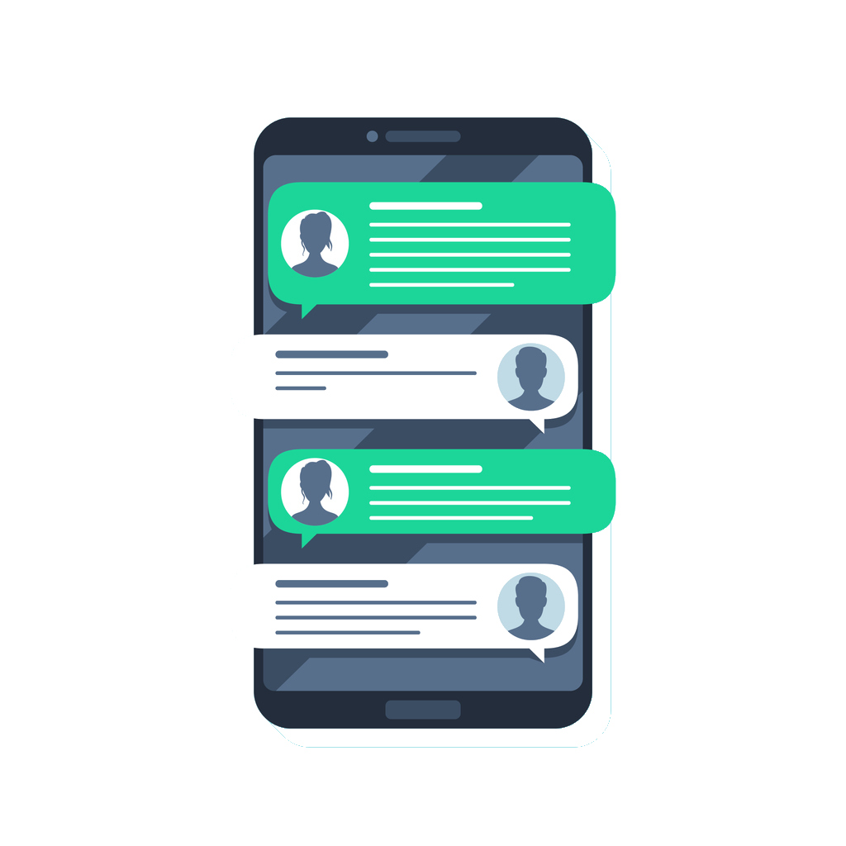
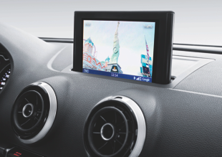
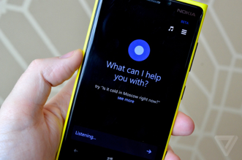


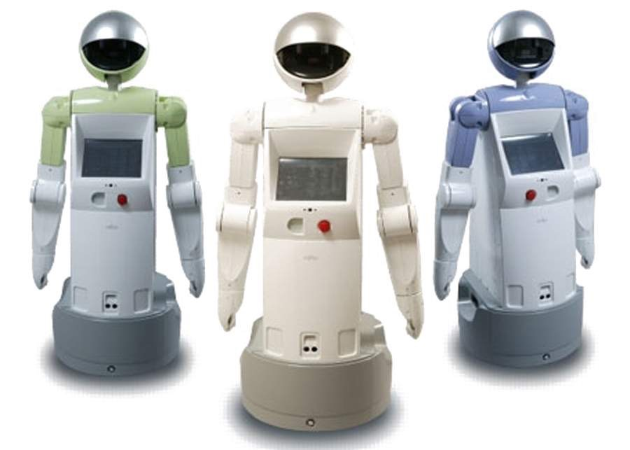
Applications
Chatbots
In-car navigation & control
Virtual assistants
Tutoring systems
Service robots
Smart home environments

Slide 8
Basic architecture
Representation of user intent (discrete category, embeddings from LLM, etc.)
Language
Understanding
Generation / response selection
User
input signal
(user utterance)
output signal
(machine utterance)

Slide 9
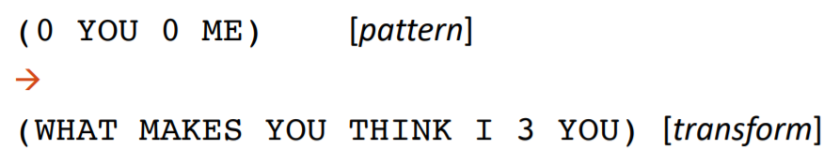
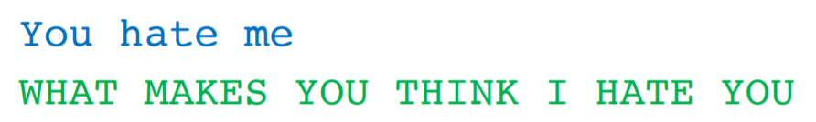
Rule-based models
Pattern-action rules
For instance:
[example from D. Jurafsky]

Slide 10
NLU-based chatbots
Language
Understanding
Generation / response selection
Difficult to write handcrafted patterns to robustly detect the user’s intent
Alternative: frame language understanding as a classification problem, and learn/fine-tune a classifier from data

Slide 11
Intent recognition
Goal: map user utterance to its most likely intent
Input: sequence (of characters or tokens) + possibly preceding context
Output: intent (what the user tries to accomplish)
Intent= GetInfoOpenHours
Intent recognition
Response selection
"When is the recycling station open?"
"The recycling station is open on weekdays from 10 to 18"

Slide 12
Intent recognition
Many possible classification models:
  Classical machine-learning models with a predefined set of features (bag-of-words, manually defined features, etc.)
  Encoder LLMs with a classification head
  (= logistic regression where the input features are the final embeddings computed from the input text)
  Decoder LLMs where the generated response is constrained to the predefined intent categories
Notes:
12

Slide 13
Intent recognition with an encoder LLM
  Example of BERT-like encoding with classification on the special [CLS] token:
Distribution over intents (linear layer + softmax)
Final embeddings
(after N layers)
= multinomial logistic regression
…
…
…
…
…
…
Embeddings after one layer
Initial embeddings
[CLS]
When is ... open ?
(special classif. token)
Notes:
13

Slide 14
Intent recognition with a decoder LLM:
P(GetInfo) = 0.78
…
Distribution over next token
Final embeddings
(after N layers)
…
…
…
…
…
Embeddings after one layer
Initial embeddings
When is ... open ?

Slide 15
Intent recognition
Need to collect training data to learn this classification model
  Data: user utterances (+ context) manually annotated with their intent(s)
  Often annotated by "chatbot trainers" in industry
Multiclass or multilabel?
  If a user input always have one intent → Multiclass
  If the input may have multiple (or zero) intents → Multilabel

Slide 16
Intent recognition
What if we don’t have any data for the fine-tuning?
In-context prompting with an instruction-tuned LLM often provides surprisingly good results
Your task is to find the most likely intent for the given user input provided through a chat interface.
Possible intents are:
1) AskForOpeningHours
Examples: When is your store open?
2) …
Just print the intent, without any explanation or comment.
User Input: “Are you guys open right now?”
Corresponding Intent:

Slide 17
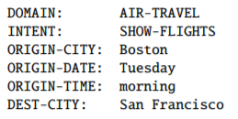
Slot filling
In addition to intents, we also sometimes need to detect specific entities ("slots"), such as mentions of places or times
Slots are domain-specific
  And so are the ontologies listing all possible values for each slot
«Show me morning flights from Boston to San Francisco on Tuesday»

Slide 18
Slot filling
Can be framed as a sequence labelling task (as in NER), using e.g. BIO schemes
O
O
B-ORG
I-ORG
O
Final embeddings
(after N layers)
…
…
…
…
…
…
Embeddings after one layer
Initial embeddings
Where is Norsk Regnesentral ?

Slide 19
Slot filling
O
O
B-ORG
I-ORG
O
Final embeddings
(after N layers)
…
…
…
…
…
Embeddings after one layer
Initial embeddings
Token-level classification task
  Output classes: BIO-prefixed categories
Slot-filling models also need to be trained / fine-tuned on annotated training data
Possible to fine-tune intent classifier and slot filler with the same model

Slide 20
Response selection
Response selection
Given an intent, how to create a response?
In commercial systems, often written by hand
  Need to retain control over the system responses (liability concerns, etc.)
  Sometimes in templated form: "{Place} is open from {Start-time} to {Close-time}"
Intent
System response
NLU
User utterance
Notes:
20

Slide 21
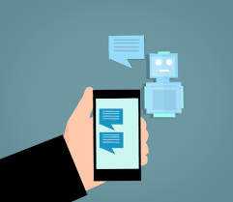
Next steps
In the next video, we will see other types of dialogue systems:
  Retrieval-based systems, which rely on a corpus of dialogues to find a relevant response to the user query
  Generative systems, which use LLMs (encoder-decoders or just decoders) to produce the response token by token

