Slide 1
Systems thinking

Slide 2
Objectives
The course starts with very detailed, isolated, small problems. Towards the end we bring in complexity of socio-technical systems.
Both sets of knowledge are important; the tree and the forest
Introduce systems thinking, and discuss how this is useful for us

Slide 3
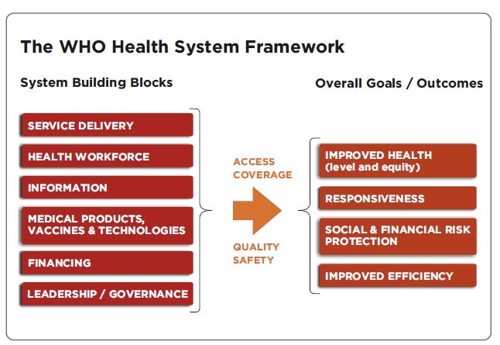
Your experiences?
Can think of system as something with input-process-output
Or an interconnected whole of several parts
What systems can you think of from your work?

Slide 4
Common systems characteristics
Self-organizing
  system arises from the dynamic interaction between actors
Constantly changing
  System adjust and readjust at many interactive time scales
Tightly linked
  Change in one sub-system affects other
Governed by feedback
  Controlled by feedback-loops
Non-linear
  Relationships are unpredictable, cannot be reduced to input-output
History dependent
  Short-term effects may differ from long-term. Time delays..
Counter-intuitive
  Cause and effect are often distant in time and space
Resistant to change
  Seemingly obvious solutions may fail or worsen the situation

Slide 5
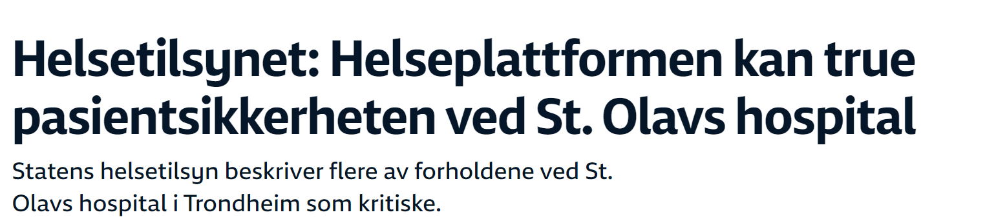
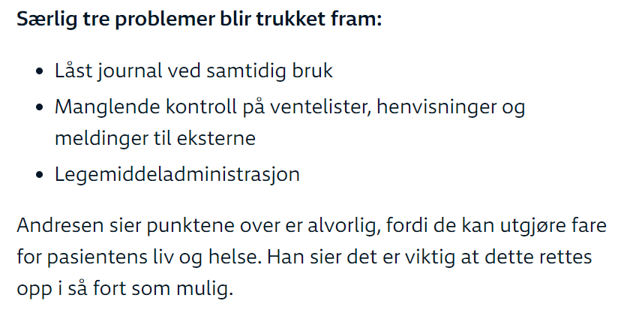
Other examples?

Slide 6
How should we deal with this:
Systems thinking
From static thinking to dynamic thinking
  Patterns rather than particular events
From system-as-effect to systems-as-cause
  Behaviour comes from internal actors, not external
From Tree-by-tree to Forest thinking
  Knowing requires understanding of context and relationships
From factors to operational thinking
  From list of things that correlate, to concentrating on causality
From straight-line to loop thinking
  Causality does not run in one direction, there is dependencies, feedback

Slide 7
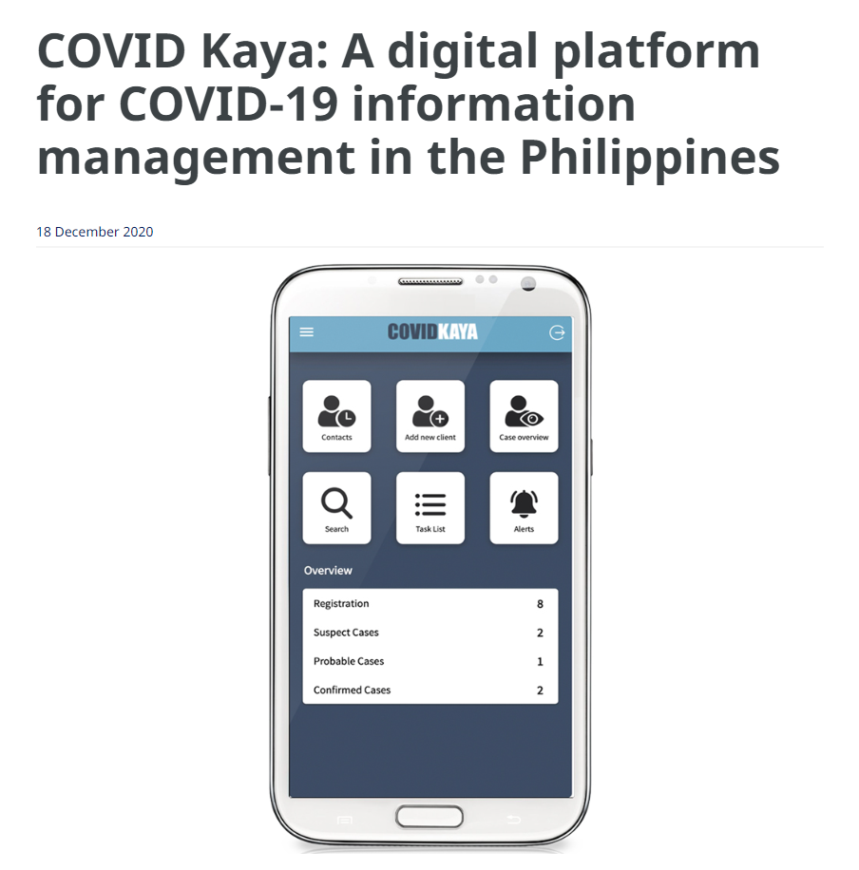
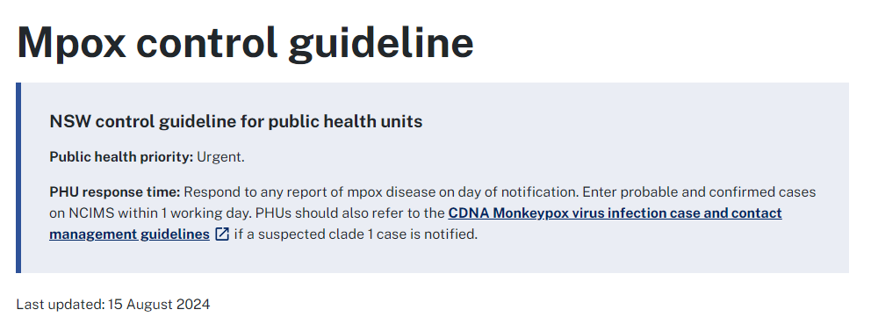
Example: Static thinking vs dynamic thinking
Current diseases vs patterns

Slide 8
Health Information Systems
The health system has “information” as a building block. But health information systems are also systems, with sub-systems, connected to the whole
The example of PMTCT in Tanzania
The bottom line is this: health information systems are complex.
  (Engine is complicated; many parts, but acts in a predictive way. A system is complex; often behaves in unanticipated and unintended ways)

Slide 9




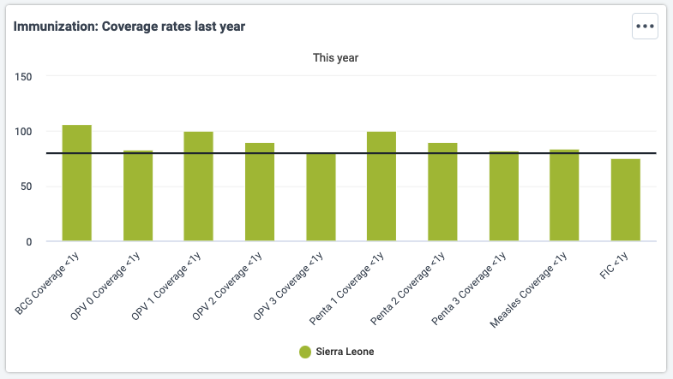
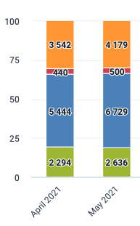


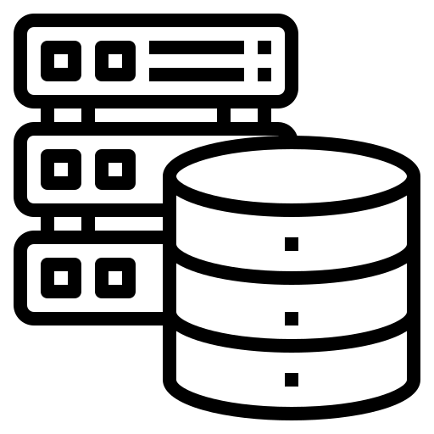
Different context
Practices
Different domains
Other HIS
Heterogeneity
“Users”
“IT designers and developers”
Legal system
“Security”
“Clients”
Licenses
Procurement
“Servers and databases”
Regulations

