Slide 1
Introduction to administrative routines for research assistants at IKOS
Everything you need to know as a new RA at IKOS.
Department of Culture Studies and Oriental Languages

Slide 2
Table of Contents
1. New RA? What you need know...
5. Routines for ordering contracts
2. Routines for hosting and restaurant bookings
6. Routines for ordering posters
7. Routines for communication and webpages
3. Routines for booking travels
4. Routines for reimbursements and honorariums
8. Routines for GDPR and media

Slide 3
1. New RA? What you need know...
Work hours are registered in the Self-Service Portal if one is on an hourly contract.
The project leader is your closest contact; in the administration, your contact person is Tarjei (tarjeibr@ikos.uio.no).
All questions regarding procurement may be addressed to Sigurd (innkjop@ikos.uio.no). Feel free to drop by his office at PAM474.
As RA, you may be asked to process sensitive information; furthermore, you are also at risk of hacking. Use therefore your university e-mail at work at ALL TIMES.
If you are working outside of university grounds, it may be advantageous to use and/or install UiO's program kiosk. Using this platform, you can work from home as though you were using a university PC.
In the event that you should fall victim to hacking or phishing, change your password immediately and report the incident to the university's digital security team UiO-CERT. Don't feel ashamed – this happen.
Data storage regulations guide.

Slide 4
2. Routines for hosting and restaurant bookings
Before you even consider ordering anything, contact innkjop@ikos.uio.no to receive help and guidance. As an employee at IKOS, you may not order anything without the department's consent.
UiO has a series of agreements with various providers of goods and travel services. One may not circumvent these agreements and expect reimbursement for the expenses.
Please make sure to submit an inquiry/order to innkjop@ikos.uio.no in good time before the delivery/event date, AT LEAST 7 WORKING DAYS.
Please check out UiO’s guidelines for hosting and representation. The rates will be elaborated on on other slides, but it is helpful to get to know the guidelines overall.
  We do not use the rates for representation.
IKOS has two forms for booking food orders and restaurants. Please keep in mind that, as a rule of thumb, food should be served on university grounds.
  Ordering catering
  Booking a restaurant
  Send the form along with a list of participants and a program (or similar documentation) to your procurer.
  For simple hosting, open events or in cases where it’s impossible or impractical to fix a list of participants, please submit an estimate of the number of participants with description and number. Example: “Open day for students”; example of refreshments: gløgg and gingerbread.

Slide 5
2. Routines for hosting and restaurant bookings, cont.
  Ordering food and booking restaurants adhere to certain rates (à 2022). Rates PER PARTICIPANT.
Event length | Hosting in UiO’s locales | Hosting outside of UiO’s locales
≤ 3 hours during work hours | Kaffe/kr 197* | kr 296
> 3 hours during work hours and lasting into lunch time | kr 197 | kr 296
> 3 hours and extending beyond work hours | kr 446 | kr 669
Long-hour events requiring two meals | kr 652 | kr 979

Slide 6
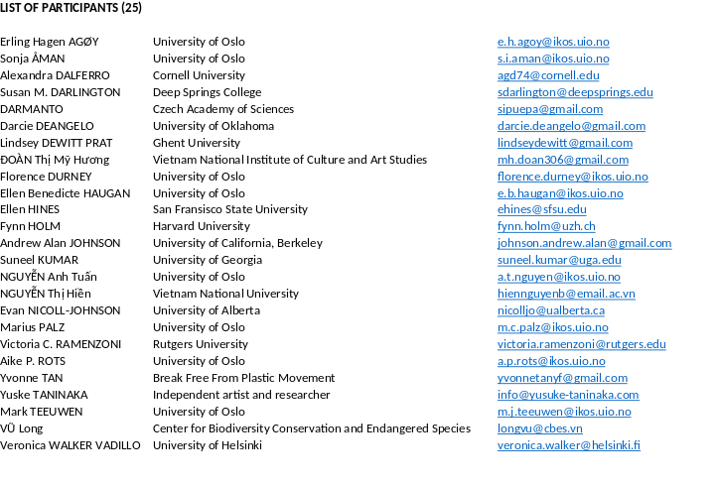

2. Routines for hosting and restaurant bookings, cont.
Example of list of participants
When booking catering or restaurants, a list of participants and description/program for the event are required.
For restaurant bookings…
  … it may be helpful to call ahead to the restaurant or check their menu to get the sense of price levels for the online form below.
  … you must always make sure that the restaurant can provide an EHF-invoice before booking. Clarify this in the above-mentioned call.
  … the table should be booked at least one WEEK in advance.
  … you or project leader must bring along a print-out of the order to the restaurant and clarify that they must write down the order number/E-number on the invoice.
  … one may only buy two units of alcohol/glasses of wine, one for the starter and one for the main course.
  … guests must pay for the meal themselves if they surpass the rates. Guests may not add tips to the invoice.
  … UiO will not cover the meal if the booking comes too late.
Useful links:
  Mat og servering - For ansatte - Universitetet i Oslo (uio.no) (In Norwegian)
  Guidelines for hosting and representation at UiO - University of Oslo
  Invoice: electronic invoice - University of Oslo (uio.no)
Example of event program

Slide 7
Rules and rates.
As a rule, food and beverages should not be served at internal meetings unless external participants are present.
As a rule, events are to be held in UiO locales, but for practical reasons, dinner may be eaten at restaurants.
HF has decided that hosting in private homes may not be covered.
The department management has decided that we only serve simple meals when hosting (baguettes/wraps/breadrolls, mineral water and coffee)

Slide 8
Rates
Event duration | Events with catering on UiO's permises | Events with catering outside UiO’s premises
≤ 3 hours during work hours | Kaffe/kr 197* | kr 296
> 3 hours during work hours and lasting into lunch time | kr 197 | kr 296
> 3 hours and extending beyond work hours | kr 446 | kr 669
Long-hour events requiring two meals | kr 652 | kr 979

Slide 9
How to host?
There are four different kinds of hosting:
Simple snack (rolls and coffee)
Simple lunch
Dinner
Lunch and dinner

Slide 10
Simple snack for open events; under 3 hours during work hours
A simple snack (such as coffee and baked goods) may be served during short-duration events with external participants, for instance lectures/seminars open to students and other externals:
Example of open seminar:
Announced on IKOS’ event page:
«Jews, Palestine, and Zionism in the Persian Gulf 1890-1948»
Time and place: Sep. 8, 2022 12:15 PM–1:30 PM, Eilert Sundts hus, A-blokka aud. 6
Join us for a Thursday seminar with Eirik Kvindesland on connections between Palestine and the Persian Gulf.
NB! For open events such as these, a list of participants is not required. Instead, please submit a short description of the event and estimated number of participants. Ex.: «Open seminar with (…), estimated number of participants is X based on earlier experience.» As a program, submit a poster/invitation to the event where it’s stressed that the event is open.

Slide 11
Events lasting more than 3 hours and extending into the lunch break
Keep in mind: Simple lunch may always be served if there are external participants present (see rates for simple snack)
«Lunch time» is defined as taking place between 11-13. One may not start an event with lunch. If there are only internal participants, the academic part of the event must last at least 3 hours.
Example of program:
«Workshop on …»
Part A – discussions: 9-12
Lunch: 12-13

Slide 12
More than 3 hours and lasting beyond work hours – dinner
In order to host dinner, the academic share of the event must last at least 3 hours and last beyond work hours – in general, external participation is also required. Work hours last until 16.00 (or until 15.00 between 15.05. and 15.09.).
Dinner must be served as part of an event. In practice, this means that dinner may not be served later than two hours after the end of the academic part.
Example:
«Workshop on…»
Part A – discussions: 14-17:
Dinner at xxxx 19-21.

Slide 13
Long-hour events requiring two meals – lunch and dinner
In order to host events with both lunch and dinner, the event must last for the whole day and extend beyond work hours. In practice, the first half of the event should meet the requirements for lunch (more than three hours of academic activity extending into lunch hours), while the second half should meet the requirements for dinner (more than 3 hours of academic activity extending into afterhours).
Ex.:
«Workshop on …»
Part A – discussions: 9-12
Lunch: 12-13
Part B – more discussion: 13-17:
Dinner at xxxx 19-21.

Slide 14
Conference hotels
Rule of thumb is that UiO’s locales are used to hold meetings/seminars/etc.
For larger events/conferences, booking conference hotels with the option to stay for a period of time may be relevant. Contact Tarjei (tarjeibr@ikos.uio.no) if you are planning something like this.
The limit for direct orders from a single provider is at 100 000 NOK. If one seeks to spend more on one provider’s services, offers must be submitted through a bidding round.
Over 200 000 NOK necessitates a simple bidding competition (prepare in good time).

Slide 15
Følgende satser for arrangementer av ulik lengde gjelder( per sept. 2022)
Event duration | Events with catering on UiO's permises | Events with catering outside UiO’s premises
≤ 3 hours during work hours Under 3 hours during work hours (provided there are externals present) | Coffee/kr 197* | kr 296
> 3 hours during work hours and lasting into lunch time More than 3 hours during work hours and lasting into lunch time | kr 197 | kr 296
> 3 hours and extending beyond work hours More than 3 hours and lasting beyond | kr 446 | kr 669
Long-hour events requiring two meals Enduring and necessary with two meals (since lunch is consumed on UiO premises, but dinner is eaten at a restaurant, the rate is divided into 197,- for lunch and 669,- for the restaurant. | kr 652 | kr 979

Slide 16
3. Routines for booking travel
Before you even consider booking anything, contact our booking specialist (Vetle, v.s.lovbakken@ikos.uio.no) for help and guidance. As an employee at IKOS, you may not book anything without the department's consent.
In principle, all trips are to be booked through the Berg-Hansen travel agency.
When booking trips for guests, rule of thumb is that the booking specialist books everything with some exceptions.
Keep in mind that we are obliged to adhere to rules for cancelling. Contact Vetle if someone notifies you that they are going to cancel their trip/stay.
Hotel stays may be booked at agreement price while the conference takes place at UiO.

Slide 17
4. Routines for reimbursement and honorariums
Before you even think about reimbursing anything, contact tarjeibr@ikos.uio.no for help and guidance. As an employee at IKOS, you may not reimburse anything without the department's consent.
If you hear talk of honorariums, you as an RA should not do anything other than submit the information with you find on the next slide to f-team@ikos.uio.no.
If there is talk of reimbursement, see the following example for how the necessary info can be gathered:
  Please keep in mind that reimbursements are only paid AFTER the assignment/trip has ended.
  Please keep in mind that we only reimburse the cheapest ticket class and that we do not reimburse taxi expenses.
Reimbursement:
UiO employees: please book your travels via Berg-Hansen and submit your reimbursement claim in self-service portal (DFØ) within 1 month of travel end. Koststed: 14200000, delprosjekt: **********. If the system does not allow you to change the codes, insert them in the comment field together with the reference to Sathya Sritharan.
External foreign participants: submit the payment abroad form (attached) and your phone number with country code to (ditt navn) within 1 month of travel end. We will register you with an account in our digital accountancy system to be able to make a reimbursement. Please submit by 1 month of travel end :
1) Entire airline itinerary showing names, fare class, dates of travel, and the amount paid and a copy of boarding pass,
2) Itemized receipt from the hotel,
3) The programme of the event.
Indicate the following in the comment field: stedkode: 14200000, delprosjekt: **********, ref. (ditt navn), IKOS.
External Norwegian participants: send your phone number with country code to (ditt navn) and complete Online form Refusjon av utlegg på BetalMeg - løsning - Nettskjema within 1 month of travel end. Please submit by 1 month of travel end :
1) Entire airline itinerary showing names, fare class, dates of travel, and the amount paid and a copy of boarding pass,
2) Itemized receipt from the hotel,
3) The programme of the event.
Indicate the following in the comment field: stedkode: 14200000, delprosjekt: **********, ref. (ditt navn), IKOS.

Slide 18
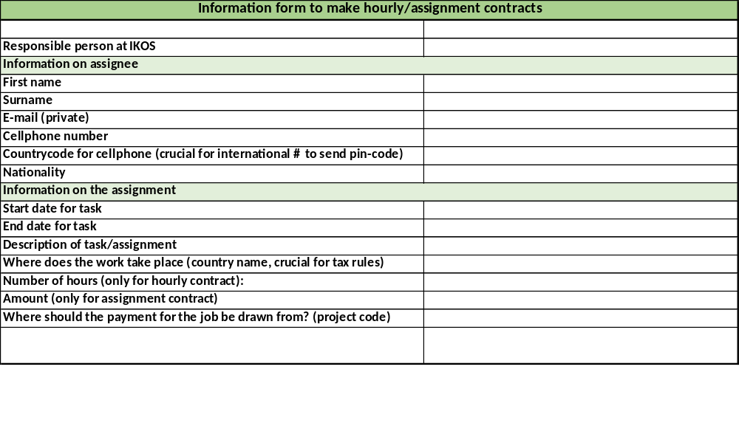
5. Routines for requesting assignment contracts
If guests or others are to receive honorarium, a contract must be made in advance. Send the following to the research administration (f-team@ikos.uio.no). Keep in mind that it may be important to stress that payment is paid out AFTER completed assignment.
Name
Cellphone number /w country code
Private e-mail
Nationality
What country the assignment is performed in if not Norway
The assignment fee/number of hours is filled in by the administration.
Example situations where a contract may be necessary:
Guest lecturers coming to hold a lecture/keynote;
Artists making an art profile for a project;
Services not including food procurement or UiO’s own services.
ALWAYS REMEMBER TO ASK PROJECT MANAGER IF ANYONE IS TO BE PAID FOR THEIR ASSIGNMENT! The contract must be prepared BEFORE the work takes place.
Form for creation of hourly/assignment contracts

Slide 19
6. Routines for ordering posters, banners and rooms
If the project manager wants to order posters, you as an RA will mostly be doing this on your own. Please keep in mind that it is totally fine to print posters at IKOS if the A4 format is sufficient. If there is demand of larger posters and banners, follow this guide:
  Prepare a PDF of what you intend to print. Be sure to run a quality check before ordering.
  To to the Graphic Centre’s UiO page. Choose UiO Orders.
  Choose the intended product and its dimensions (A2, A1, A0, roll-up, banners and so on).
  To pay, fill in «koststed» (cost centre) and «delprosjekt» (project code).
    «Koststed» is 14200000 Institutt for kulturstudier og orientalske språk.
    «Delprosjekt» is the code of the project you work for. The project manager or the administration can give you this.
  Printed items can either be delivered to a UiO address or be picked up at the printshop under the SiO building. Delivery is added onto the price.
  NB! Check, double check and triple check that the «delproject» and delivery address are correct.
Remember to verify that the project kan cover the expenses; posters can quickly get expensive.
Consider the environment! Order only as many items as you need and make fewer posters with more content than the opposite.

Slide 20
6. Routines for ordering posters, banners and rooms, cont.
When booking rooms, it may be helpful to read UiO’s guidelines for the use of rooms and locales (in Norwegian).
Rooms may be booked in two ways:
  Meeting rooms may be booked through Outlook in the same way as group rooms are. These may be booked up to 270 days ahead of time.
  Auditoriums and seminar rooms may be booked through TP: Room booking (educloud.no).
Make use of TP: Schedule Room (educloud.no) to see which rooms are occupied and when.
Merk at det er unntak, ofte med egne regelverk for bruk av rom:
  HF-12 (12th floor at Niels), Klubben and Stort møterom i GSH, Universitetsaulaen, Professorboligen, Tøyen hovedgård, and Gamle festsal require special procedures to book. All sites except for HF-12’s are in Norwegian.
  On Fridays, auditoriums and seminar rooms at GSH are open to events all day. Send a request to arrangementer@admin.uio.no to book a room.
  Contact innkjop@ikos.uio.no if you are asked to book a conference hotel. If the event takes place in Oslo, rule of thumb is that we don’t book conference hotels.
  Contact the administration (f-team@ikos.uio.no) if your project manager is planning a large-scale event (conference over the course of multiple days, etc.). We only make use of hotels with which we have an agreement if we for one reason or another must make use of them.

Slide 21
7. Routines for communication and webpages
Man får ikke lov til å publisere eller redigere sider på nett uten tillatelse.
Everyone who publishes on UiO’s webpages must have taken the following courses (all in Norwegian):
  Grunnkurs i Vortex (UiO’s webdesign client)
  Kurs i klarspråk
  Kurs i universell utforming (uu)
If one is in need of a new webpage (for a new EU-project, collaborative project wherein UiO is an equal partner, or a centre), this must be applied for through a UiO page (In Norwegian)..
  Projects, research groups, conferences and other measures where UiO plays a main role should be placed in the existing UiO folder structure with UiO design. These do not require application, but please contact nettredaktor@hf.uio.no anyway to ensure that they are fine with you making such a page.
  In most cases, articles and events do not need to be reported.
There are specific rules for the use of images on UiO websites (in Norwegian).
If you are unsure whether your webpage satisifies the requirements for universal layout (uu), send a draft to Tarjei (tarjeibr@ikos.uio.no) before publishing.
Access to Vortex is only provided at the project manager’s request.

Slide 22
8. Routines for GDPR and media
All audiovisual publishing requires and presumes that consent is collected from all participants.
  Consent should be:
    voluntary
    clear
    informed (it should be clear what the images/video/recording will be used for)
  Read more about the guidelines for handling personal data on uio.no.
  Here is a template for a consent form.
All internal lists of participation must be deleted once their purpose has been fulfilled.
  The sign-up sheet should include a section on when the lists are deleted (within a week after the event, for instance).
  The lists may not be used for any other purpose than the one(s) the participants have been informed about.
  If one wishes to combine multiple sources of data (for instance upload them to a register), the participants must be informed about this.
  Read more about data storage and sign-up sheets on UiO's websites (in Norwegian).

Slide 23
Questions?
Send mail to tarjeibr@ikos.uio.no or drop by room 478.

