Slide 1

bullying and harassment in the uh sector
National Report
MADS MOTRØEN, IPSOS
© 2019 Ipsos. All rights reserved. Contains Ipsos’ confidential and proprietary information and may not be disclosed or reproduced without the prior written consent of Ipsos.

Slide 2

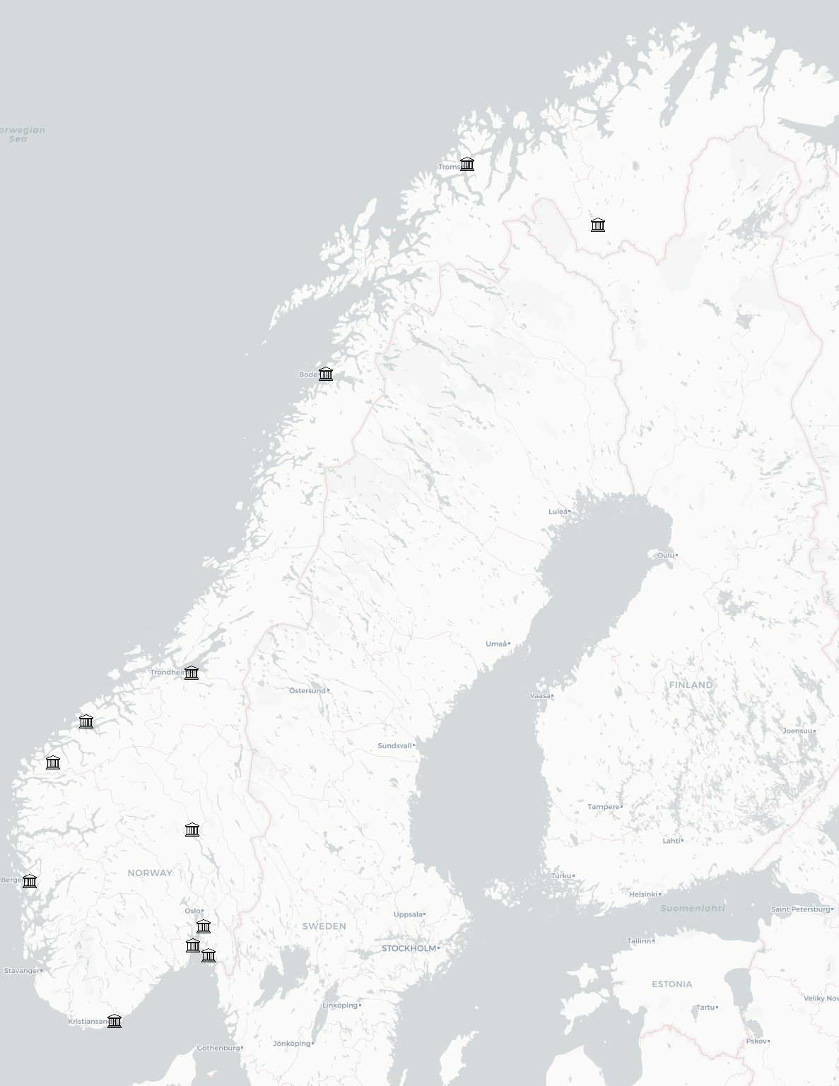


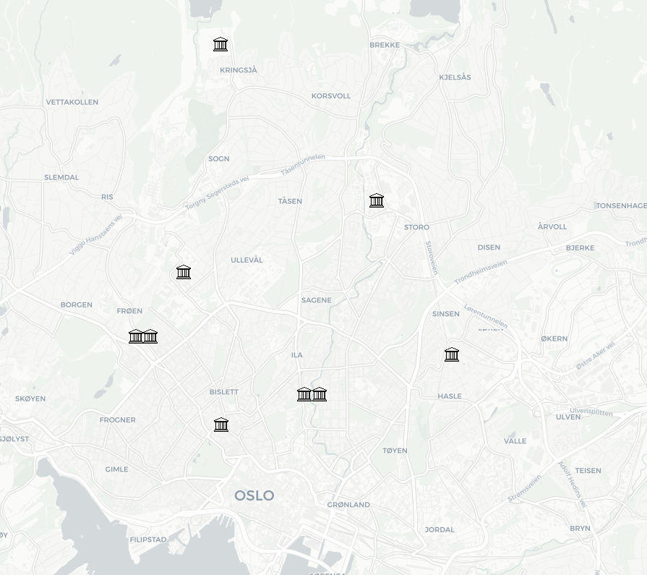


Institutions
UiT The Arctic University of Norway
NHH - Norwegian School of Economics
Sámi University of Applied Sciences
NLA University College
Nord University
Norwegian School of Sport Sciences
University of Bergen
BI Norwegian Business School
Western Norway University of Applied Sciences
Queen Maud University College of Early Childhood Education
University of Oslo
Molde University College
NTNU - Norwegian University of Science and Technology
Fjellhaug International University College
Norwegian Academy of Music
Norwegian Police University College
Volda University College
Oslo National Academy of the Arts
Inland Norway University of Applied Sciences
Oslo School of Architecture and Design
OsloMet - Oslo Metropolitan University
BERGEN REGION
OSLO REGION
University of South-Eastern Norway
Norwegian University of Life Sciences
Østfold University College
Ansgar University College and Theological Seminary
University of Agder

Slide 3
Bullying and harassment
3
© 2019 Ipsos.

Slide 4
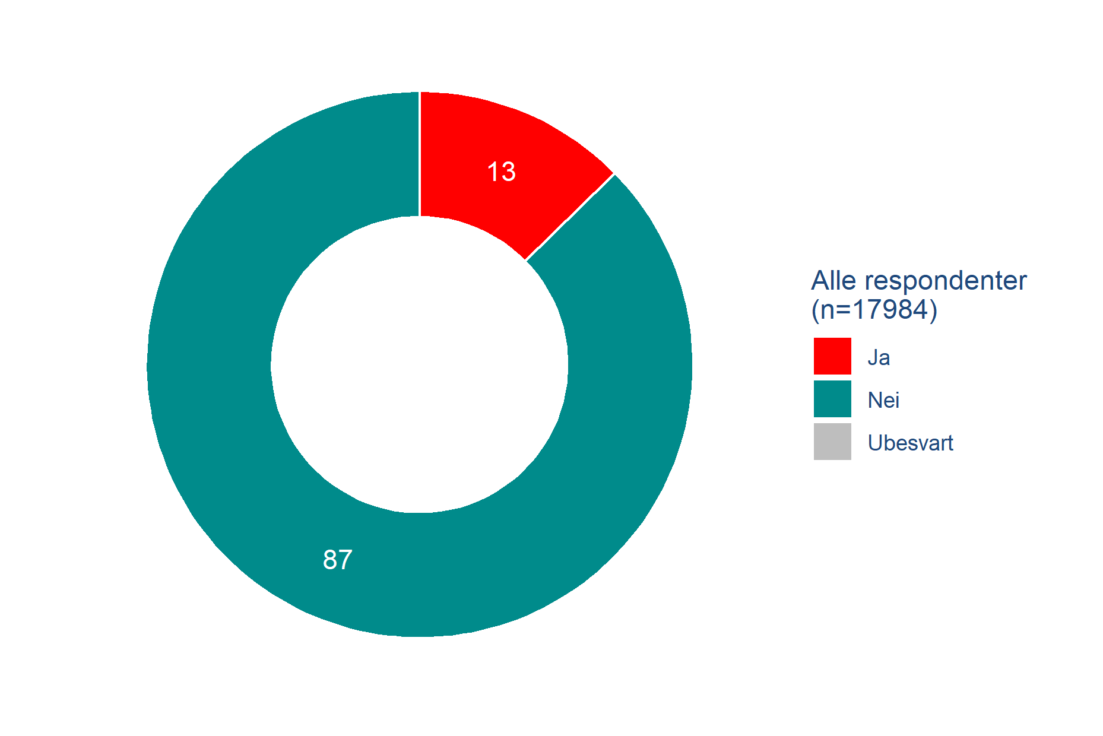
Have you been subjected to bullying or harassment in your current employment in the past 12 months?
Bullying and harassment
13 % have been bullied or harassed
13 % of the respondents stated that they have been bullied or harassed in their current employment in the past 12 months.
More women than men stated that they have been bullied/harassed.
  Women: 14 %
  Men: 10 %
29 % of respondents who defined their gender as non-binary have experienced bullying or harassment in the past 12 months.
Q7: Have you been subjected to bullying or harassment in your current employment in the past 12 months?
Base: 17,984

Slide 5
Have you been subjected to bullying or harassment in your current employment in the past 12 months?
Bullying and harassment
More older than younger respondents have been bullied/harassed.
More older than younger respondents stated that they have been bullied or harassed in the past 12 months.
  50-59 years old: 15%
  18-39 years old: 10%
There were no significant differences between those respondents with management responsibilities and those without.
Q7: Have you been subjected to bullying or harassment in your current employment in the past 12 months?
Base: 17,984

Slide 6
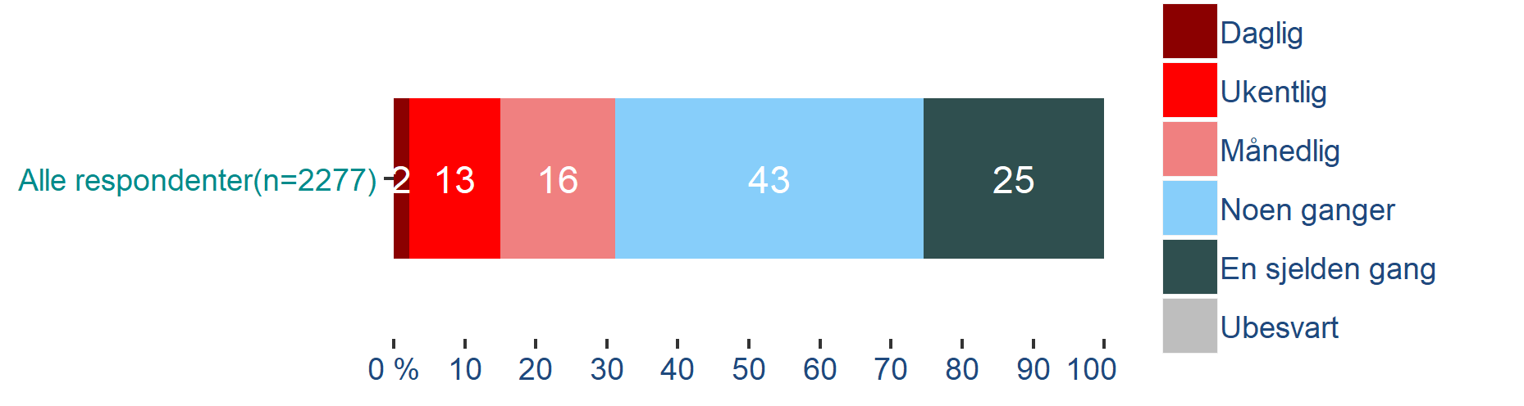
How often in the past 12 months have you been subjected to bullying or harassment in your current employment?
Bullying and harassment
Frequency of bullying or harassment
31 % (of 2,276) have experienced bullying/harassment on a monthly basis or more often. 2 % have experienced it on a daily basis and 13 % have experienced it on a weekly basis.
Therefore, around 4 % of the total sample of respondents in the survey have experienced bullying and harassment on a monthly basis, or more often, in the past year.
No gender or age differences stand out.
Q8: How often in the past 12 months have you been subjected to bullying or harassment in your current employment?
Base: 2,277 (filter: respondents who have been bullied or harassed in the past 12 months)

Slide 7
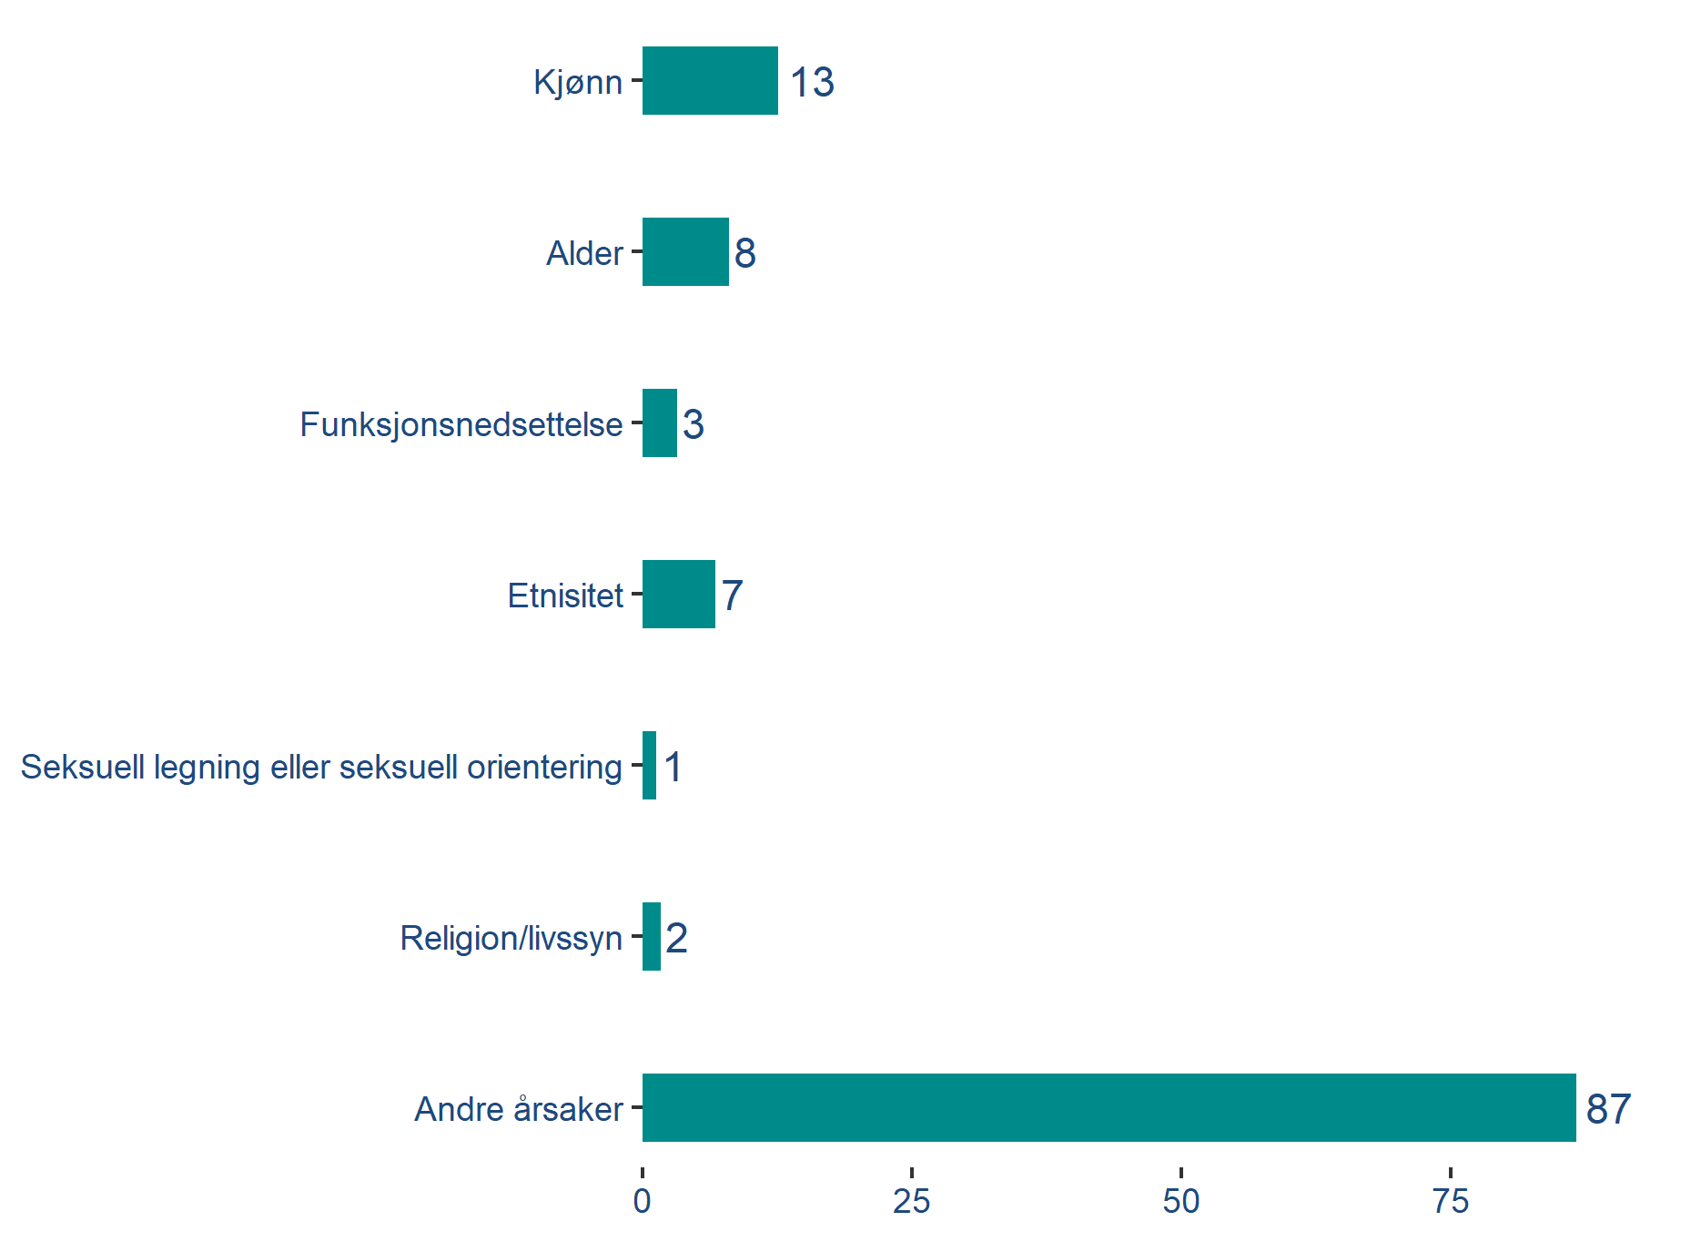
Have you been subjected to bullying or harassment on the basis of one or more of the following factors in your current employment in the past 12 months?
Bullying and harassment
Reasons other than "classic" reasons for discrimination
Gender was a reason stated most often by respondents who specified a reason. 13 % of those who have been bullied/harassed mentioned this, and this made up of 15 % of the women and 7 % of the men.
26 % of the respondents aged 18-29 who have been bullied/harassed stated gender as a reason; the percentage decreases as age increases.
22 % of PhD candidates/postgraduates/senior research fellows who have been bullied/harassed stated gender as a reason.
Generational difference: The older respondents more often stated “other reasons”.
Q9: Have you been subjected to bullying or harassment on the basis of one or more of the following factors in your current employment in the past 12 months?
Base: 2,277 (filter: respondents who have been bullied or harassed in the past 12 months)

Slide 8
Have you been subjected to bullying or harassment on the basis of one or more of the following factors in your current employment in the past 12 months?
Bullying and harassment
Bullying/harassment based on age for youngest and oldest
8 % of those who have been bullied/harassed stated age as a reason.
Both the youngest (20-29 years old – 22 %) and the oldest (60+ years old – 14 %) are overrepresented here.
So are the 7 % of those who have been bullied/harassed who stated ethnicity as a reason. These are more often younger respondents.
16 % of the 20-29 age group who have been bullied/harassed stated ethnicity as a reason.
Most of the respondents (87 %) who have been bullied/harassed stated reasons other than those the questionnaire listed as alternatives.
Q9: Have you been subjected to bullying or harassment on the basis of one or more of the following factors in your current employment in the past 12 months?
Base: 2,277 (filter: respondents who have been bullied or harassed in the past 12 months)

Slide 9
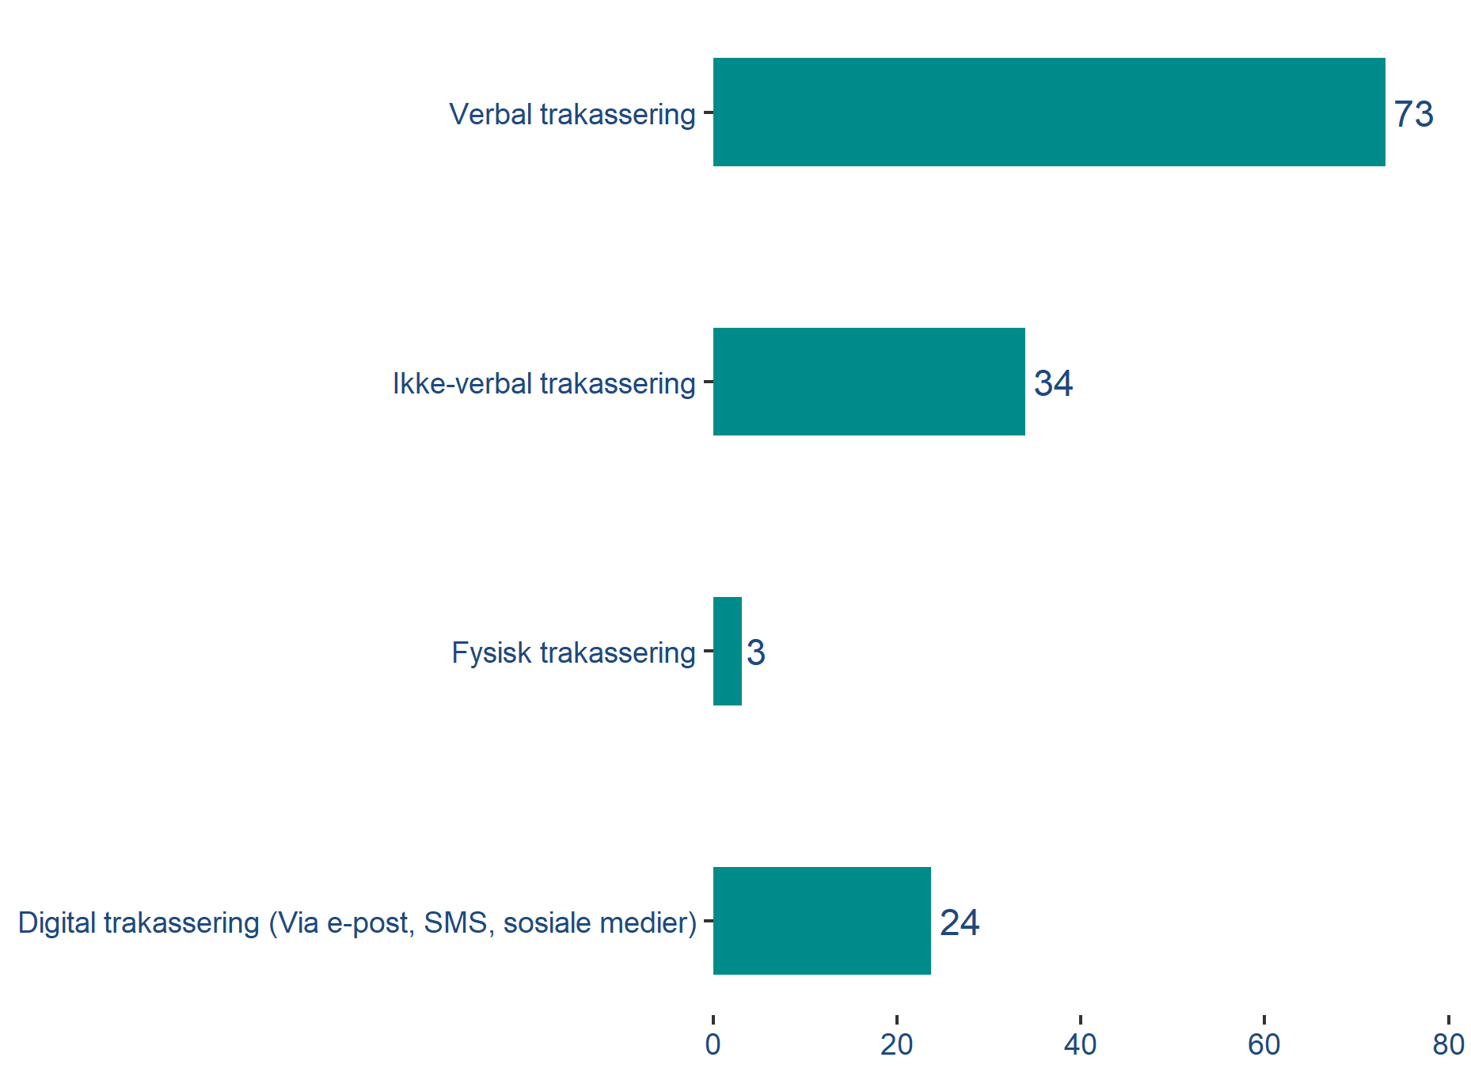
What type or types of bullying or harassment have you been exposed to in your current employment relationship over the past 12 months?
bullying and harassment
Verbal harassment most common
Verbal harassment is the most common form and occurs in 73 % of incidents.
  75 % of the women who have been harassed chose this alternative, compared with 69 % of the men.
Non-verbal harassment occurs in 34 % of incidents and includes ugly looks, ostracism, etc.
Digital harassment via email, SMS, social media, etc. occurs in 24 % of incidents. Physical harassment is the least common form and represents 3 % of cases.
Q10: Have you been subjected to any of the following forms of bullying or harassment in your current employment in the past 12 months?
Base: 2,277 (filter: respondents who have been bullied or harassed in the past 12 months)

Slide 10
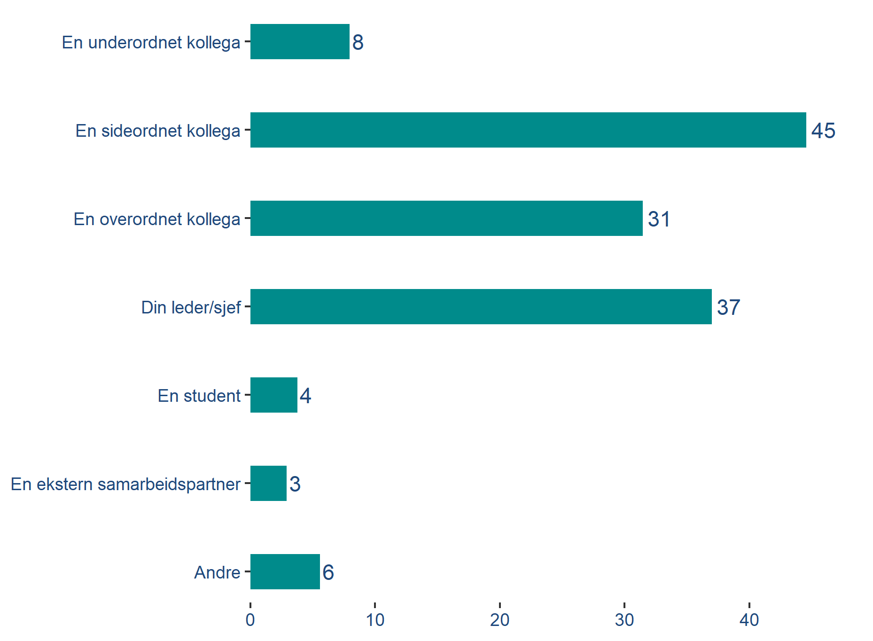
What type of position did the person subjecting you to bullying or harassment in your current employment in the past 12 months have?
Bullying and harassment
Bullying and harassment by colleagues most common
Of the respondents who have been subjected to bullying or harassment, most have experienced this from an equal colleague. This was stated by 45 % of respondents who have been subjected to bullying or harassment.
31 % of the respondents who have been subjected to bullying/harassment stated that a superior was responsible, while 37 % stated it was their manager/leader. Somewhat fewer (8 %) stated it was their subordinates, 4 % stated students and 3 % external collaboration partners.
No gender or age differences stand out.
Q11: What type of position did the person subjecting you to bullying or harassment in your current employment in the past 12 months have?
Base: 2,277 (filter: respondents who have been bullied or harassed in the past 12 months)

Slide 11
Sexual harassment
11
© 2019 Ipsos.

Slide 12
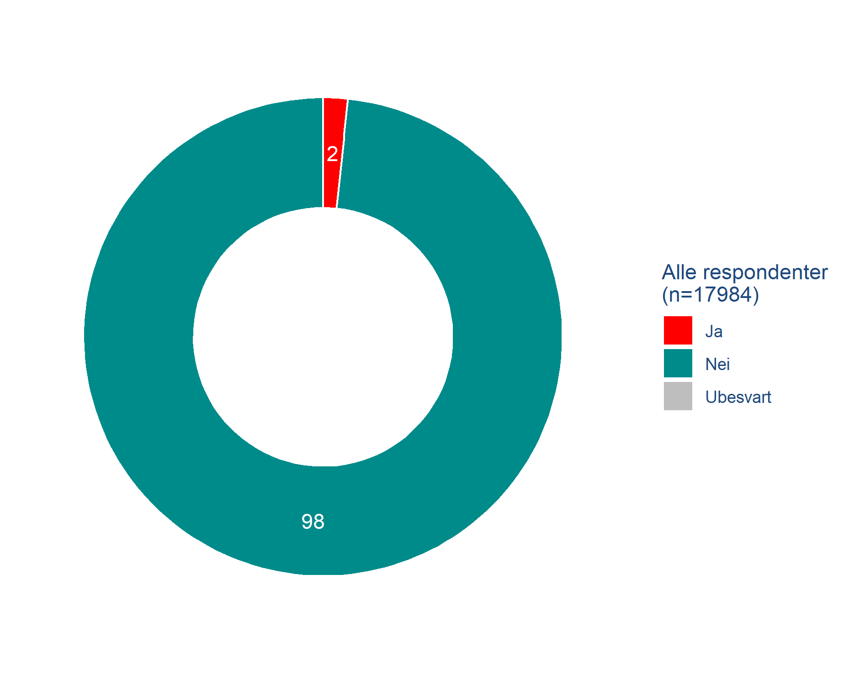
Have you been subjected to sexual harassment in your current position in the past 12 months?
sexual harassment
2 % have been subjected to sexual harassment
299 respondents, or 2 % of the total sample of respondents, stated that they have been subjected to sexual harassment in their current position in the past 12 months. This applies to 2 % of the women and 1 % of the men.
Younger respondents stated this more often than older respondents. More than half of the instances were stated by people aged 18-39 and this group accounted for 31 % of respondents.
Relatively speaking, PhD candidates/postgraduates/senior research fellows were the group that most often stated that they had been subjected to sexual harassment.
Q12: Have you been subjected to sexual harassment in your current position in the past 12 months?
Base: 17,984

Slide 13
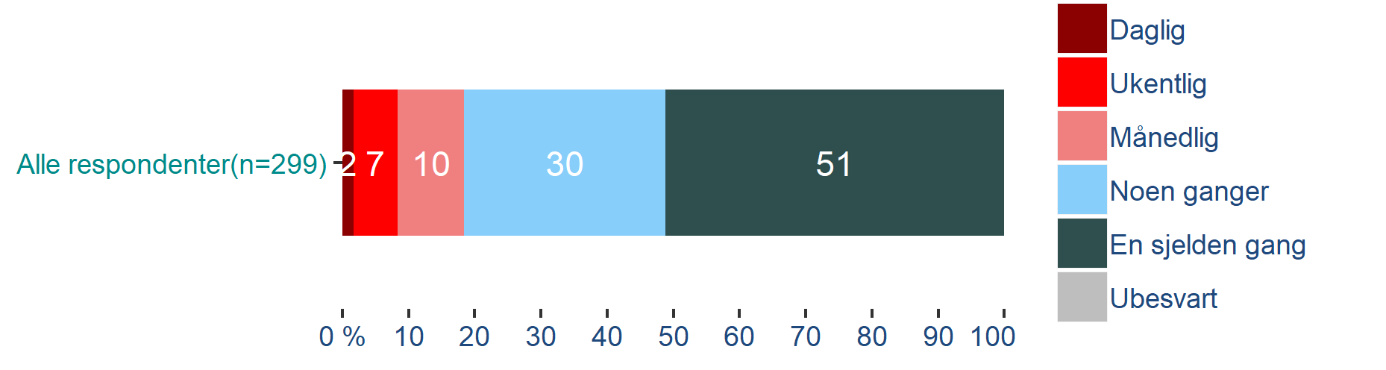
How often have you been subjected to sexual harassment in your current position in the past 12 months?
Sexual harassment
Frequency of sexual harassment
Of the 299 respondents who have been subjected to sexual harassment, 19 % have experienced it on a monthly basis or more often.
Half of them have experienced it rarely, while 30 % responded occasionally.
Slightly more PhD candidates/postgraduates/senior research fellows have experienced sexual harassment on a monthly basis, or more often, than the average.
Q13: How often have you been subjected to sexual harassment in your current position in the past 12 months?
Base: 299 (filter: respondents who have been subjected to sexual harassment in the past 12 months)

Slide 14
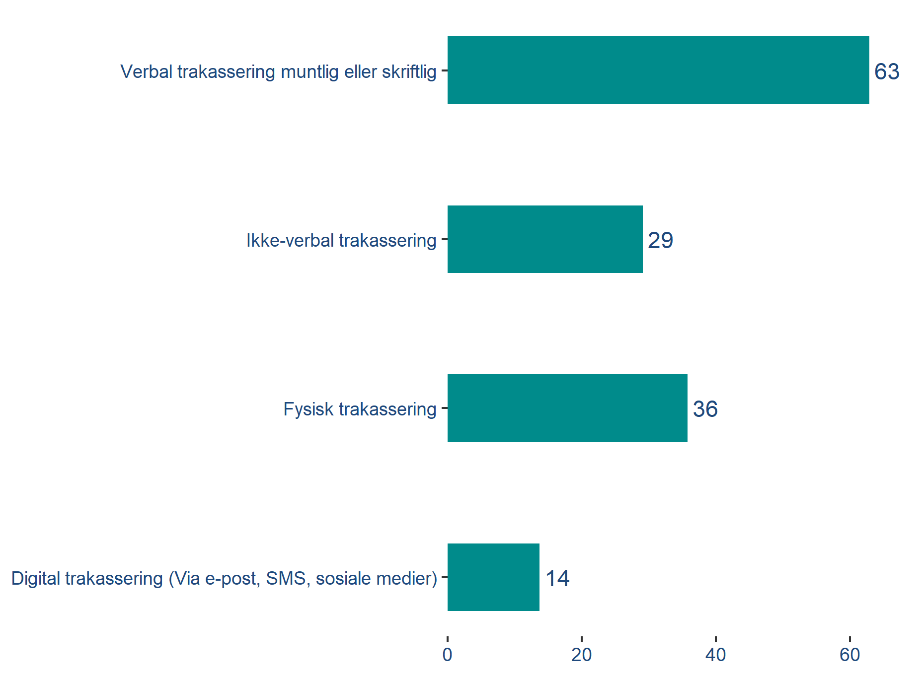
Have you been subjected to any of the following forms of sexual harassment in your current employment in the past 12 months?
Sexual harassment
Verbal harassment most common
Sexual harassment in the UH sector largely occurs verbally, although there is also a significant proportion of physical sexual harassment.
63 % of those who have been subjected to sexual harassment have experienced verbal forms of it, and there is little difference between the genders.
Relatively speaking, more men have experienced physical forms of sexual harassment. 50 % of all the men who have experienced sexual harassment have experienced physical forms of it, compared with 32% of the women.
Q14: Have you been subjected to any of the following forms of sexual harassment in your current employment in the past 12 months?
Base: 299 (filter: respondents who have been subjected to sexual harassment in the past 12 months)

Slide 15
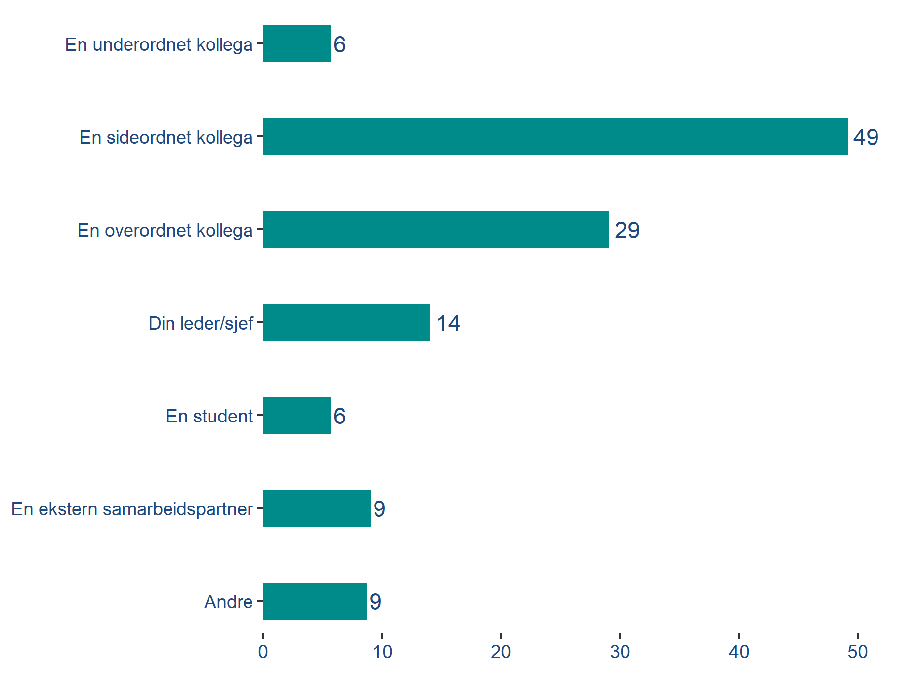
Who was it that subjected you to this?
Sexual harassment
Harassment by students is more commonly directed at men
49 % stated that an equal colleague was responsible for the sexual harassment. 14 % responded that it was their manager/leader and 29 % stated it was a superior.
6 % stated that they have been subjected to sexual harassment by a student and among these men outnumber women, both in relative and absolute terms. 12 men responded that they have been subjected to sexual harassment by a student, compared with 5 women who stated the same.
Q15: Who was it that subjected you to this?
Base: 299 (filter: respondents who have been subjected to sexual harassment in the past 12 months)

Slide 16
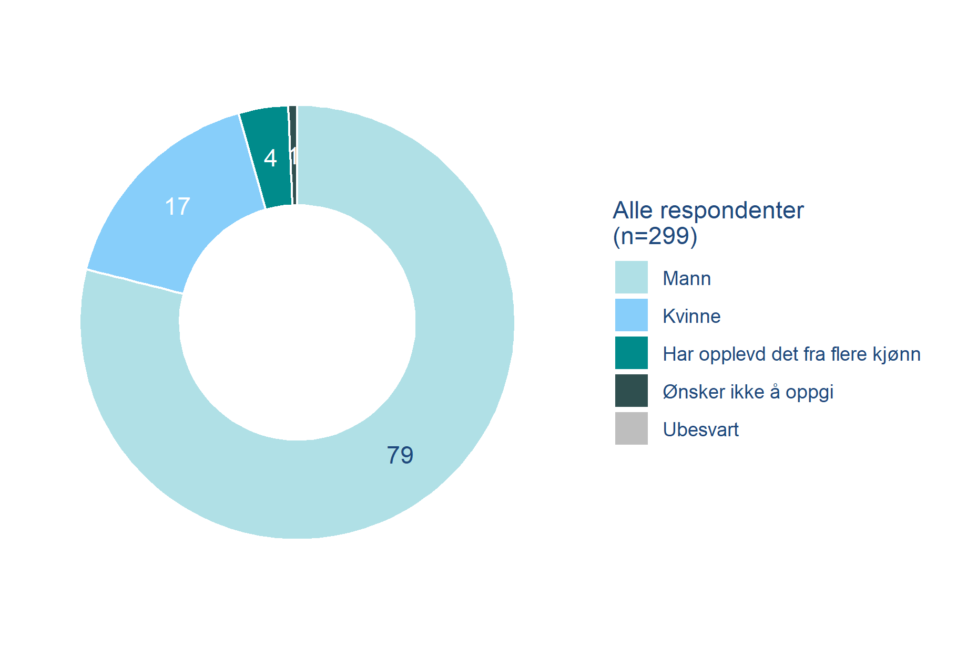
Was the person who subjected you to this:
Sexual harassment
Men responsible for most sexual harassment
Men were behind 79 % of the sexual harassment.
94 % of the women who stated that they have been subjected to sexual harassment stated that a man was behind it.
23 % of the men who stated that they have been subjected to sexual harassment stated that another man was behind it, and 71 % stated that it was a woman.
Q16: Was the person who subjected you to this:
Base: 299 (filter: respondents who have been subjected to sexual harassment in the past 12 months)

Slide 17
Sexual assault
17
© 2019 Ipsos.

Slide 18
Have you in the past 12 months, in your current employment, been subjected to a situation where someone had sexual intercourse with you through the use of force, or have you felt compelled, threatened or pressured into having sexual intercourse?
Sexual assault
4 out of 10 sexual assaults target PhD candidates/postgraduates/senior research fellows
The survey revealed a total of 18 cases of sexual assault. A further 35 respondents were not sure whether or not the incident could be described as sexual assault.
Of the 18 respondents who stated that they have been subjected to sexual assault, 11 were women and 7 were men.
Of those who were not sure, 16 were women, 17 were men and 2 defined their gender as non-binary.
PhD candidates/postgraduates/senior research fellows are subjected to sexual assaults at a higher rate than average. PhD candidates/postgraduates/senior research fellows accounted for 13% of the respondents, but reported 39% of the cases of sexual assault.
18
respondents
Q17: Have you in the past 12 months, in your current employment, been subjected to a situation where someone had sexual intercourse with you through the use of force, or have you felt compelled, threatened or pressured into having sexual intercourse?
Base: 17,984

Slide 19
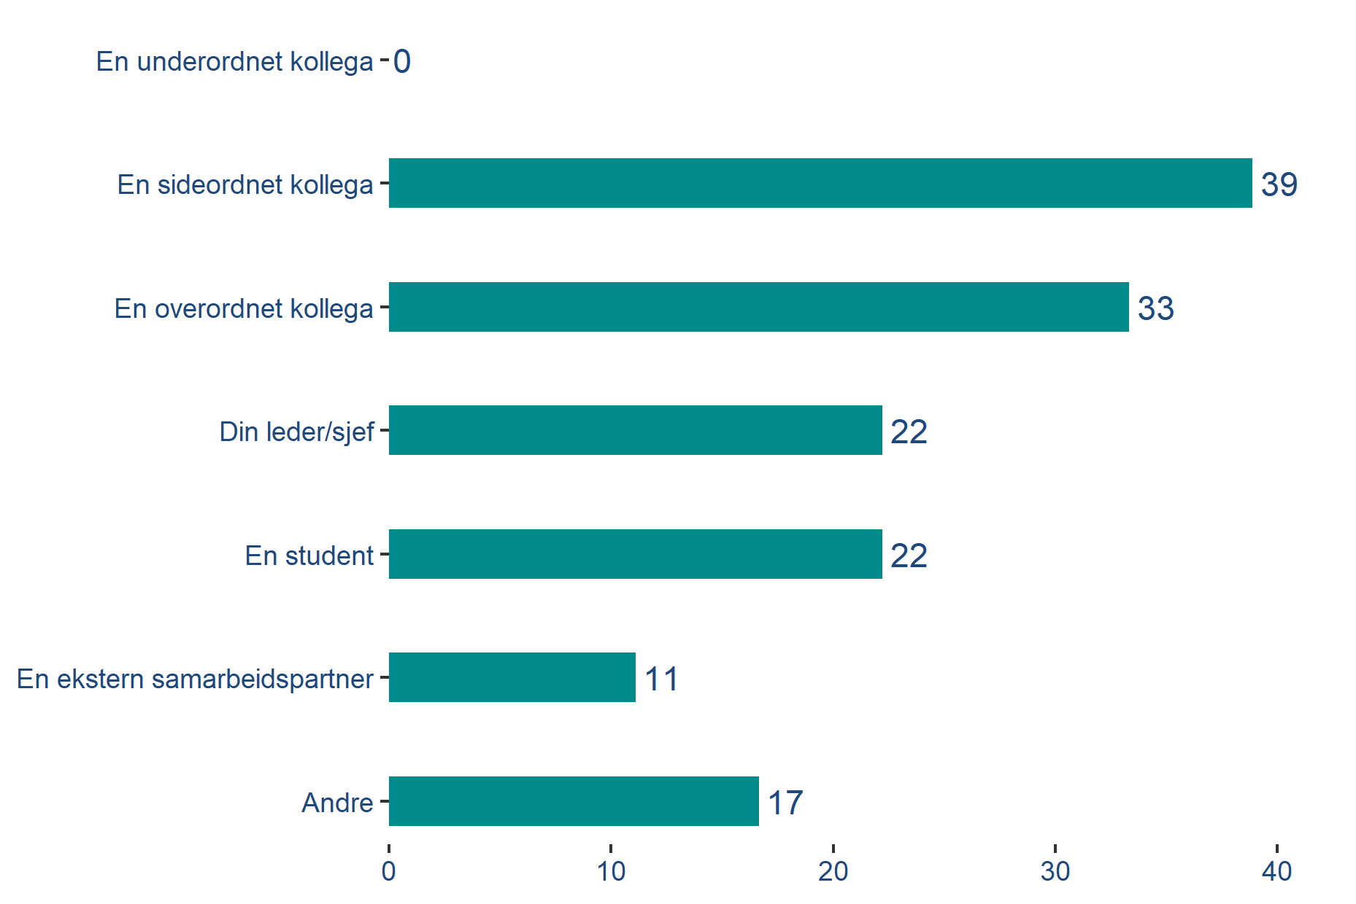
Who was it that subjected you to this?
Sexual assault
No clear pattern with respect to the perpetrator
Colleagues are behind most of the sexual assaults in academia, and 39 % of those who have been subjected to sexual assault stated an equal colleague was behind it. 33 % stated it was a superior.
Everyone who stated the perpetrator was their manager/leader was a woman. This accounts for 4 cases.
Everyone who stated the perpetrator was a student was a man. This also accounts for 4 cases.
Q18: Who was it that subjected you to this?
Base: 18 (filter: respondents who have experienced a situation where someone had sexual intercourse with them through the use of violence, force/coercion or pressure.)

Slide 20
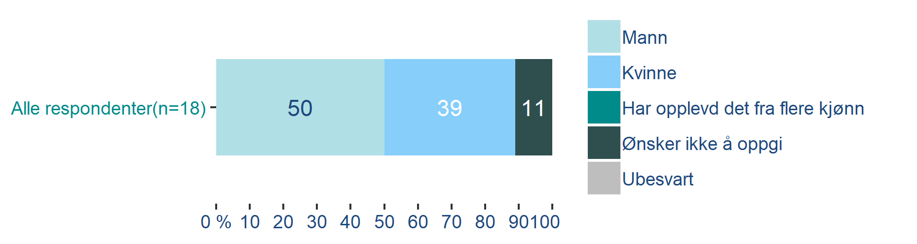
Was the person who subjected you to this:
Sexual assault
Relatively even distribution
Of the 18 respondents who stated that they have been subjected to sexual assault, 50 % responded that the perpetrator was a man (9 cases).
All of the women who have been subjected to sexual assault stated that the perpetrator was a man.
39 % (7 cases) stated that a woman was behind the assault, and of these, 1 respondent was a woman and 6 were men.
Q19: Was the person who subjected you to this:
Base: 18 (filter: respondents who have experienced a situation where someone had sexual intercourse with them through the use of violence, force/coercion or pressure.)

Slide 21
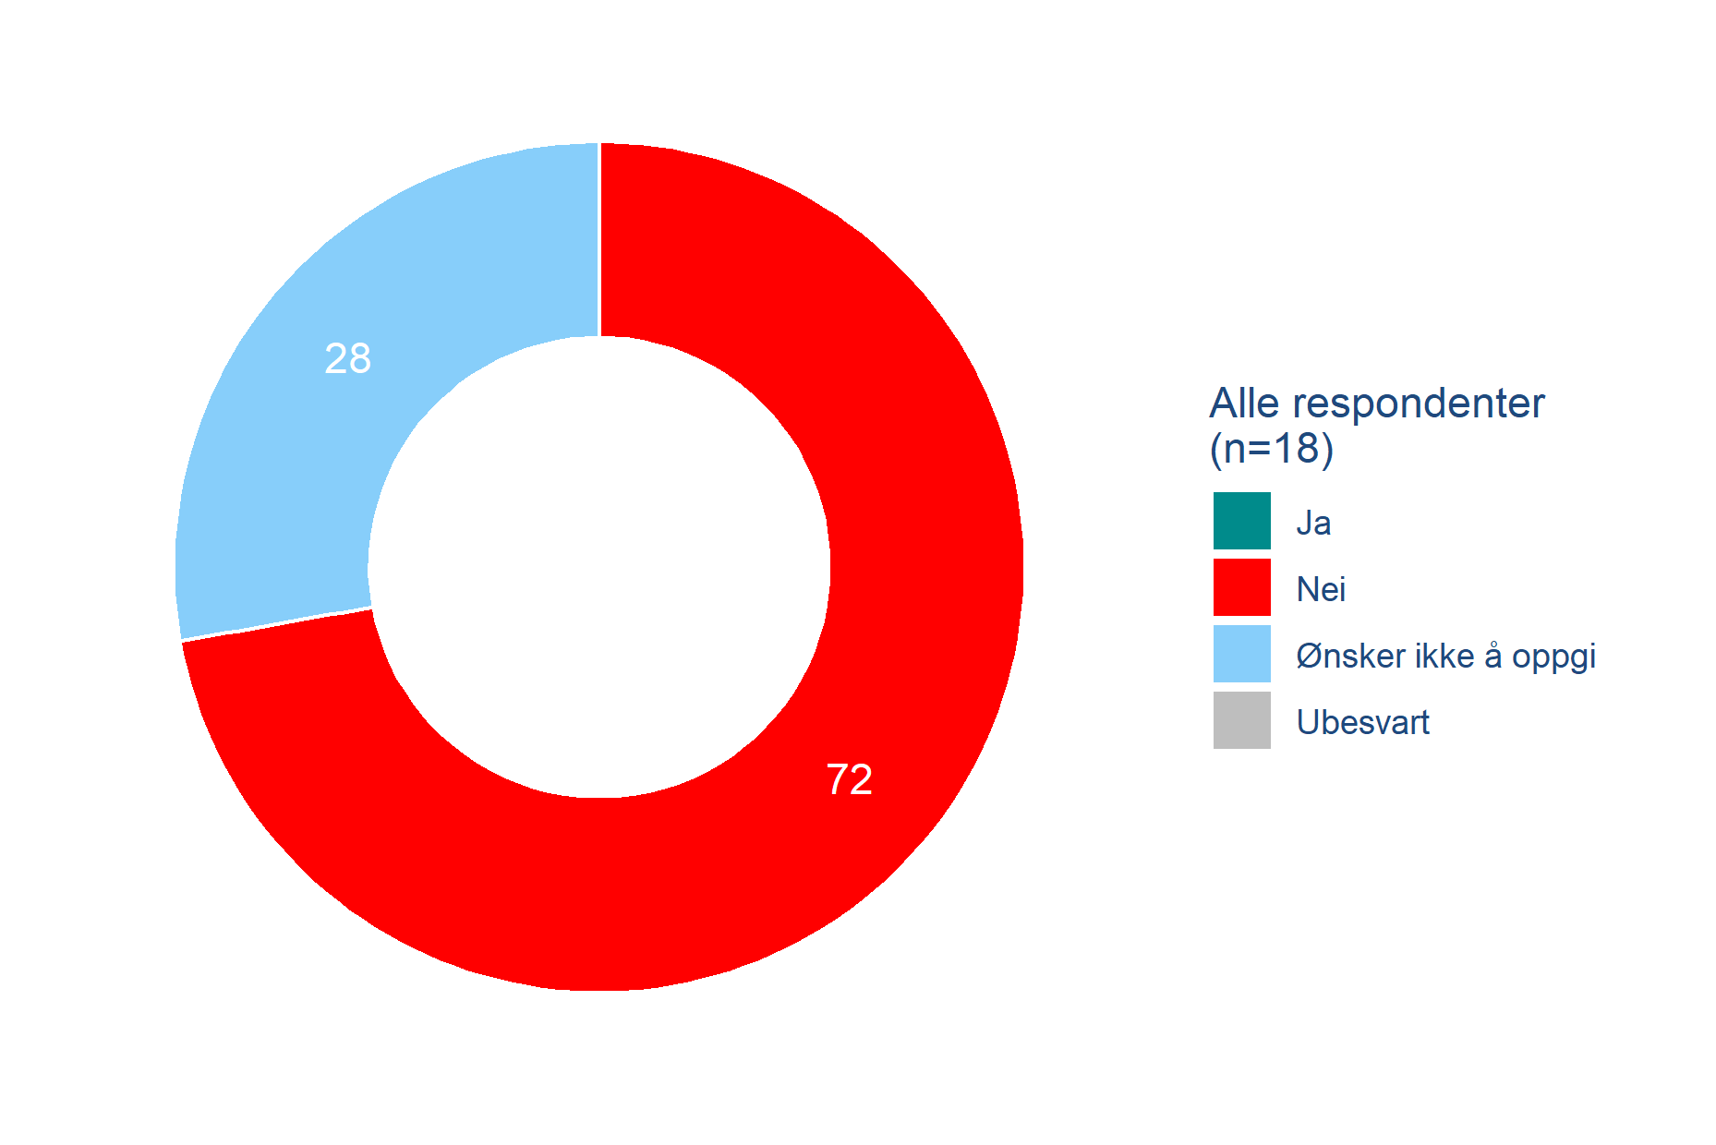
The actions outlined in connection with sexual intercourse are punishable by law, and should be handled by the police. Have you reported the issue to the police?
Sexual assault
No one stated that they had reported an assault
The survey points out that the actions outlined in the question regarding violence, force/coercion or threats in the context of sexual intercourse are punishable by law, and should be handled by the police. We then asked if the issue had been reported to the police.
None of the 18 respondents who have been subjected to rape stated that they have reported the matter. 28 % of them (5 respondents) did not wish to say, while 72 % (13 respondents) stated that they had not reported the matter.
Q19: The actions outlined in the question regarding use of violence, force/coercion or threats in the context of sexual intercourse is punishable by law, and should be handled by the police. Have you reported the issue to the police?
Base: 18 (filter: respondents who have experienced a situation where someone had sexual intercourse with them through the use of violence, force/coercion or pressure.)

Slide 22
Summary
22
© 2019 Ipsos.

Slide 23
Summary
Bullying and harassment
  13 % stated that they have been bullied or harassed in their current employment in the past 12 months.
  More older than younger respondents stated that they have been bullied or harassed in the past 12 months.
  15 % of the 50-59 age group stated that they have been subjected to bullying or harassment, which is higher than the other age groups and significantly more often than the average.

Slide 24
Summary
Bullying and harassment – overrepresentation
  Respondents over 50 years old:
    40.7 % of respondents
    44.3 % of reported bullying/harassment
  Respondents under 50 years old:
    59 % of respondents
    55.6 % of bullying/harassment

Slide 25
Summary
Sexual harassment
  299 respondents stated that they have been subjected to sexual harassment in their current position in the past 12 months. This represents 1.6 % of respondents.
  2.2 % of the women and 0.9 % of the men have been subjected to sexual harassment, and they are more often younger than older.
  PhD candidates/postgraduates/senior research fellows were the group that most often (in percentage) stated that they had been subjected to sexual harassment.

Slide 26
Summary
Sexual harassment – overrepresentation
  Female respondents:
    60 % of respondents
    78.9 % of reported sexual harassment
  Respondents under 40 years old:
    30.5 % of respondents
    51.2 % of reported sexual harassment
  PhD candidates/postgraduates/senior research fellows:
    12.5 % of respondents
    23.1 % of reported sexual harassment

Slide 27
Summary
Sexual assault
  The question concerning sexual assault was formulated as follows:
    Have you in the past 12 months, in your current employment, been subjected to a situation where someone had sexual intercourse with you through the use of force, or have you felt compelled, threatened or pressured into having sexual intercourse?
  The wording of the question is similar to sections 291(a)-291(c) of the Penal Code which deals with rape.

Slide 28
Summary
Sexual assault
  The survey registered 18 cases of sexual assault in connection with respondents’ employment in the past 12 months.
  A further 35 respondents stated don’t know/not sure, which indicates that they have been subjected to an incident that they are not sure matches the description in the questionnaire.
  PhD candidates/postgraduates/senior research fellows stated more often than other groups that they had been subjected to sexual assault.

Slide 29
Summary
Sexual assault – overrepresentation
  PhD candidates/postgraduates/senior research fellows:
    12.5 % of respondents
    39 % of reported assaults (7 out of 18 cases).
  They are strongly overrepresented.

Slide 30
Conclusions
30
© 2019 Ipsos.

Slide 31
Summary
CONCLUSIONS
  The proportion that have been bullied/harassed is significant.
  Relatively few stated the common reasons for harassment (gender, ethnicity, sexual orientation, etc.) as the reason for the harassment.
  This indicates the existence of a number of other causes of bullying/harassment in academia that the survey has not identified.

Slide 32
Summary
CONCLUSIONS
  The survey reveals a generational difference.
  Bullying and harassment affected senior respondents to a greater degree and the group over 50 years of age is overrepresented.
  The younger respondents have been subjected to sexual harassment and sexual assault to a far greater degree, and respondents under 40 years old/PhD candidates/postgraduates/senior research fellows are relatively strongly overrepresented.

Slide 33
Summary
CONCLUSIONS
  The figures for both sexual harassment and sexual assault show that PhD candidates/postgraduates/senior research fellows are an especially exposed group.
  PhD candidates/postgraduates/senior research fellows are overrepresented in the figures for both sexual harassment and sexual assault.
  PhD candidates/postgraduates/senior research fellows accounted for 12.5 % of the respondents, but reported
    23.1 % of all sexual harassment
    38.9 % of all sexual assault

Slide 34
Contact Ipsos
Arild Sæle
Project manager
Mads Motrøen
Responsible for analysis and reporting
Linn Sørensen Holst
Manager
arild.sæle@ipsos.com
mads.motroen@ipsos.com
linn.holst@ipsos.com
+47 926 63 227
+47 995 87 968
+47 975 94 285

